Slide 1
A case for propensity score weighting: a doubly robust estimator for overlap weights
Lucy D’Agostino McGowan

Slide 2

http://bit.ly/wfu-lucy

Slide 3
Vanderbilt University
Supplementing clinical trials with EHR data
Analyzing data analysis techniques
Data science pedagogy
Johns Hopkins
p-hack-athon
tidycode
TED-Ed
Understanding Data and Statistics in Medical Literature
Causal inference
Multi-reader multi-case ROC curves
VA Health Outcomes
ATO Doubly Robust estimator and Variance estimation
Sensitivity to Unmeasured Confounding
ATM and ATO weights finite sample bias
Notes:
To start off, I just wanted to show a large overview of the problems I've been working on in my doctoral and postdoctoral work. Broadly, I get excited about identifying a large problem in the scientific community and finding a way statistics can help.

Slide 4
Vanderbilt University
Supplementing clinical trials with EHR data
Analyzing data analysis techniques
Data science pedagogy
Johns Hopkins
p-hack-athon
tidycode
TED-Ed
Understanding Data and Statistics in Medical Literature
Causal inference
Multi-reader multi-case ROC curves
VA Health Outcomes
ATO Doubly Robust estimator and Variance estimation
Sensitivity to Unmeasured Confounding
ATM and ATO weights finite sample bias
Notes:
For this talk, I am just going to focus on two areas I’ve contributed to

Slide 5
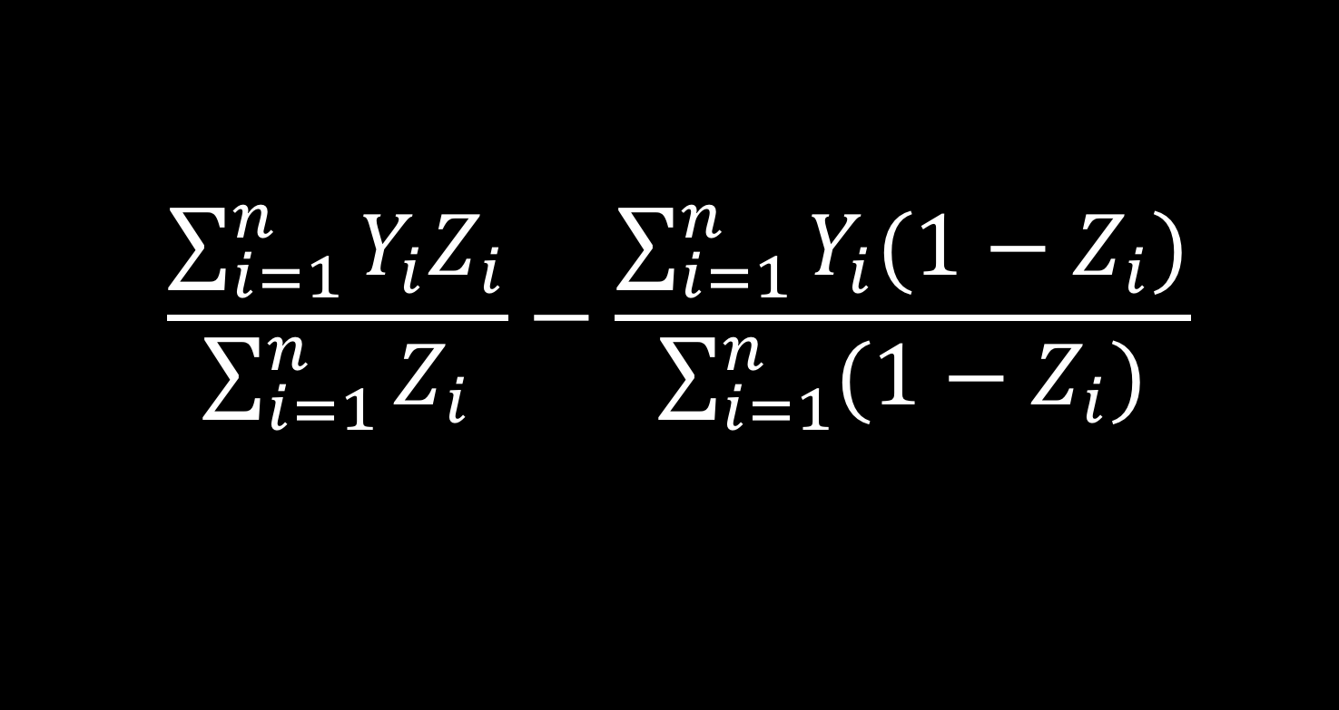
$$\frac{\sum_{i=1}^{n}{Y_{i}Z_{i}}}{\sum_{i=1}^{n}{Z_{i}}}−\frac{\sum_{i=1}^{n}{Y_{i}(1−Z_{i})}}{\sum_{i=1}^{n}{(1−Z_{i})}}$$
Notes:
The way this talk is going to work is I will have some equations for those of you who get excited about understanding precisely what I’ve done, but they will always be coupled with a high level visual explanation to clarify, so if you aren’t quite following the equation, just hang tight for the high level explanation, and if something still isn’t clear, please interrupt me I’m happy to clarify at any point

Slide 6
https://xkcd.com/552/
Notes:
I want to start of by showing this xkcd comic. This is a pretty famous one, many of you have probably already seen it. SO here the protagonist states "I used to think correlation implied causation, then I took a statistics class, now I don't" and his friend says "sounds like the class helped" which the protagonist replies

Slide 7
https://xkcd.com/552/
Notes:
"well...maybe". This is such a great joke, and a bit of a jab at modern statistics for a few reasons. First of all, it highlights the catch phrase that pretty much everyone associates with our field "correlation is not causation", but it also highlights that in general we ARE interested in casual effects, for example here, the friend is implying that the course CAUSED the protagonist to learn something about statistics, the joke being that he couldn't quite be sure if the class is what taught him that, maybe he would have thought of it on his own anyways!

Slide 8
Sometimes we are interested in a causal effect
Notes:
Despite the fact that we have really hammered home this idea that correlation isn't causation, I contend that sometimes we are interested in a causal effect

Slide 9
Sometimes we are interested in a causal effect
Often
Notes:
And in fact, I would say often we are interested in a causal effect. For example, we don't just care that smoking is correlated with lung cancer incidence, it matters that smoking actually CAUSES lung cancer. So how can we tell the difference between two things that are correlated and relationships that are causal?

Slide 10
Causal inference
Notes:
Well there's a field known as "causal inference" that seeks to answer this very question.

Slide 11
Wake Forest University Seminar
Notes:
The field of causal inference is quite expansive. For this talk, I am going to introduce you to this world and address two gaps I’ve tried to fill. There is a new propensity score weighting scheme that was introduced in 2016, my contributions build on this new weight.

Slide 12
To Do:
Define propensity score
Define propensity score weight
Define these new weights
Wake Forest University Seminar
Notes:
Okay just in that sentence there were three concepts that may not have been total clear, so on our [click] todo list is to [click] define what a propensity score is [click] define what a propensity score weight is [click] and then to define these new weights that I mentioned

Slide 13
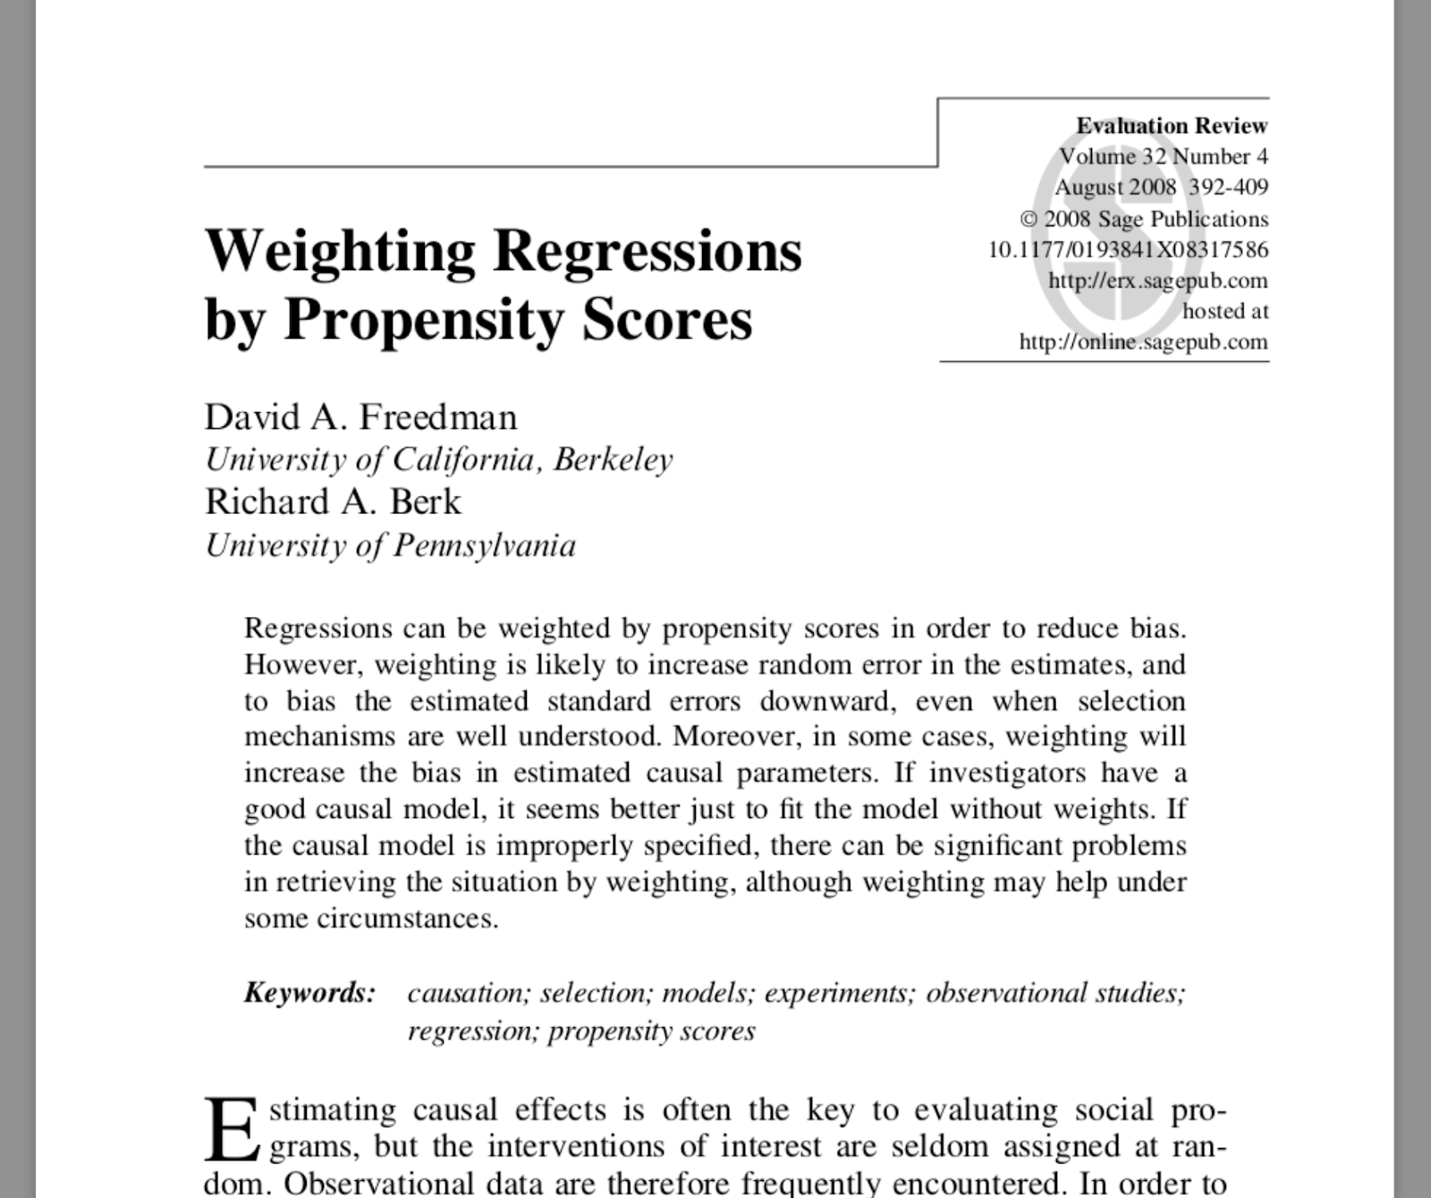
Doubly robust estimator
Wake Forest University Seminar
Notes:
In 2008 a paper came out claiming that using propensity score weights was bad both in terms of bias and variance

Slide 14
Refute some claims!
Wake Forest University Seminar
Notes:
Okay so the first gap I filled is to refute some of these claims

Slide 15
Refute some claims!
Doubly robust estimator
Wake Forest University Seminar
Notes:
It turns out that this paper used something known as a doubly robust estimator and this doubly robust estimator has not been defined for these new weights, so before I can refute any claims I need to derive this along with a large sample variance estimator. so this motivates the rest of my talk

Slide 16
To Do:
Define propensity score
Define propensity score weight
Define these new weights
Wake Forest University Seminar
Notes:
So now we have something new to add to our list

Slide 17
To Do:
Define propensity score
Define propensity score weight
Show our doubly robust estimator
Define these new weights
Wake Forest University Seminar
Notes:
Define what it means to be doubly robust and show the estimator I've derived

Slide 18
To Do:
Define propensity score
Define propensity score weight
Show our doubly robust estimator
Define these new weights
Refute some
claims
Wake Forest University Seminar
Notes:
and then I'm going to refute some claims

Slide 19

Notes:
I just want to give a sneak peek at my results, since I'm going to be spending some time on background, I want to make sure you all have a good idea of where we're heading.

Slide 20
BAD
Old weights
New weights
Notes:
So here is a graph that I will be showing in more detail later in the talk - then it will have a real y-axis, legend, etc. But for now, let's just assume that going up vertically is bad, horizontally I have my sample size, the blue line [click] shows a traditional propensity score weighting method, and the purple line [click] shows the new weighting method. SO pretty much regardless of sample size, the new weights are consistently better than the old weights. And the old weights improve as the sample size increases. I'm going to be diving into the nitty gritty here so you'll have a much better idea of what is going on, but I just wanted to give a little sneak peek to get everyone excited about this topic.

Slide 21
To Do:
Define propensity score
Define propensity score weight
Show our doubly robust estimator
Define these new weights
Refute some
claims
Wake Forest University Seminar

Slide 22
To Do:
Define propensity score
Define propensity score weight
Show our doubly robust estimator
Define these new weights
Refute some claims
Wake Forest University Seminar

Slide 23

Observational Studies
exposure
outcome
Notes:
A lot of my research so far has been in the observational study space. Like many statistical questions, our goal here is to assess the relationship between some [click] exposure, and some [click] outcome.

Slide 24

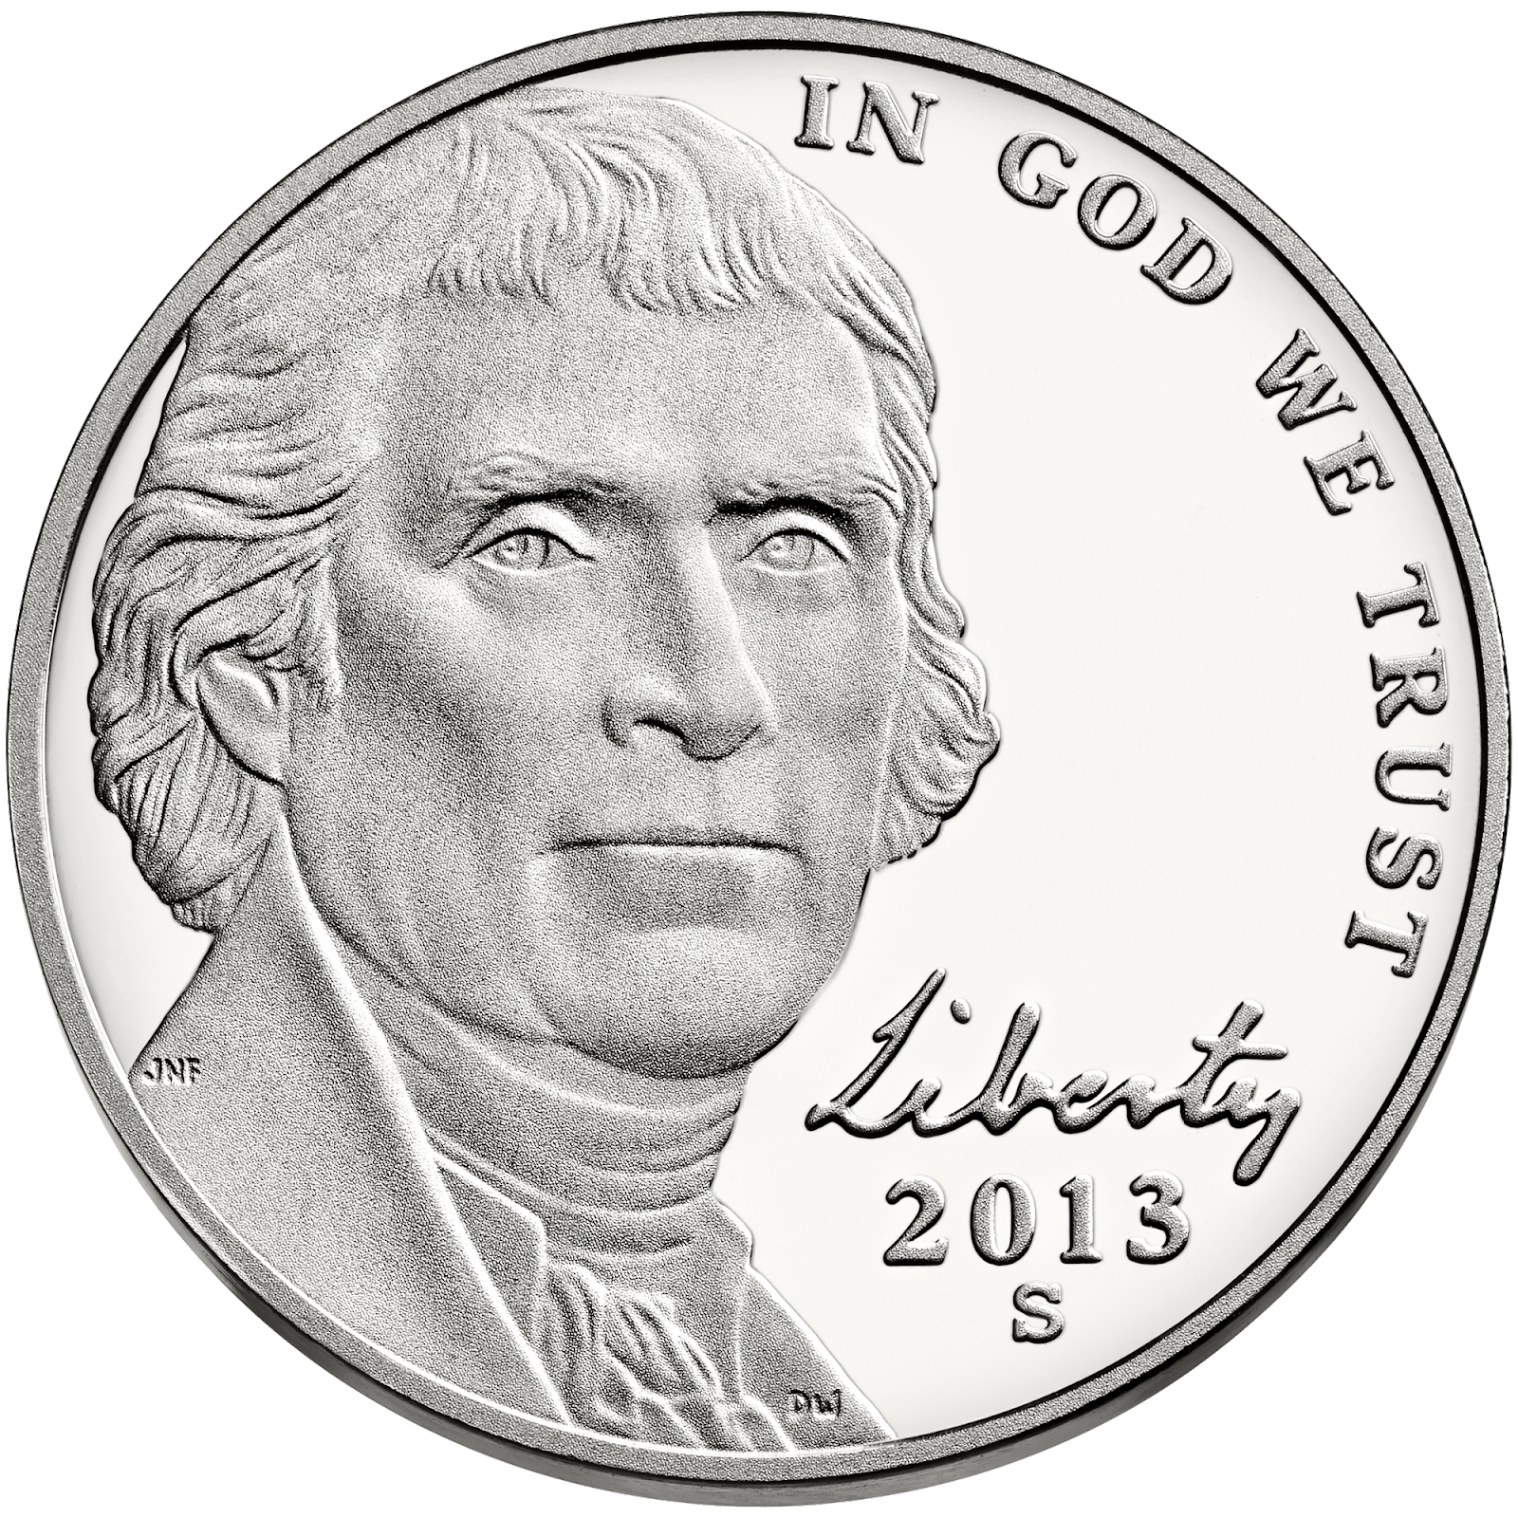

Observational Studies
Randomized Controlled Trials
Treatment
P=0.5
Control
P=0.5
Notes:
An observational study is distinct from a [click] randomized controlled trial. A randomized study works something like this [click] a participant is assigned to either the [click] treatment or control group [click] this treatment assignment is via some random process, in the simplest case something like a coin flip. We know the probability of treatment assignment and often participants are just as likely to have been assigned to the treatment group as the control group

Slide 25
Observational Studies
Randomized Controlled Trials
Exposure
P=0.5
Control
P=0.5
Notes:
It need not be a treatment, it could be any exposure

Slide 26
Observational Studies
Randomized Controlled Trials
A
P=0.5
B
P=0.5
Notes:
In the data science world, sometime this is known as A/B testing, for example you may randomly assign some website visitors to see a new promotion. And you'd be interested in assessing how that promotion effects sales. A lot of the terminology for the line of causal inference that I will be discussing came out with the medical field as the direct application, so I will be using the words "Treatment" and "Exposure" interchangably

Slide 27
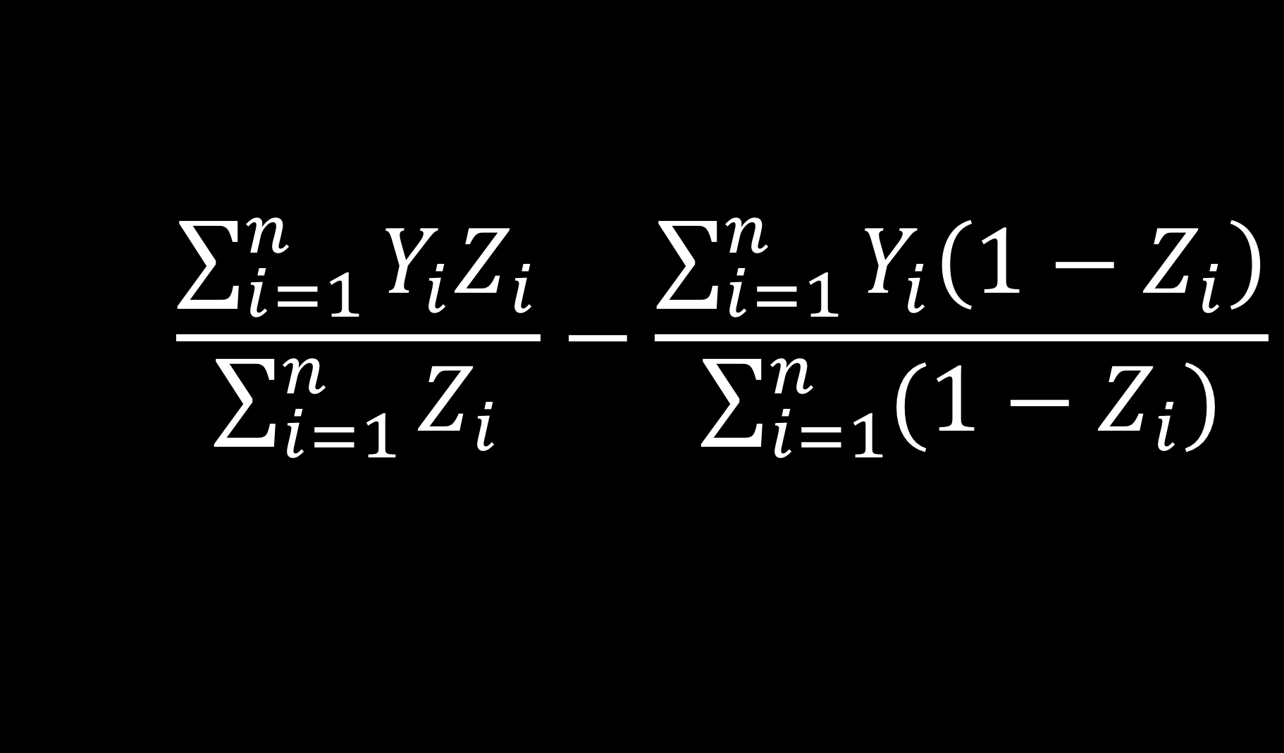
Estimate exposure effect
Notes:
In this randomized setting, we can just take the the difference between the mean outcome among the exposure and the mean outcome among the controls. I'm showing this specific notation because we are going to build on it in the subsequent slides.

Slide 28
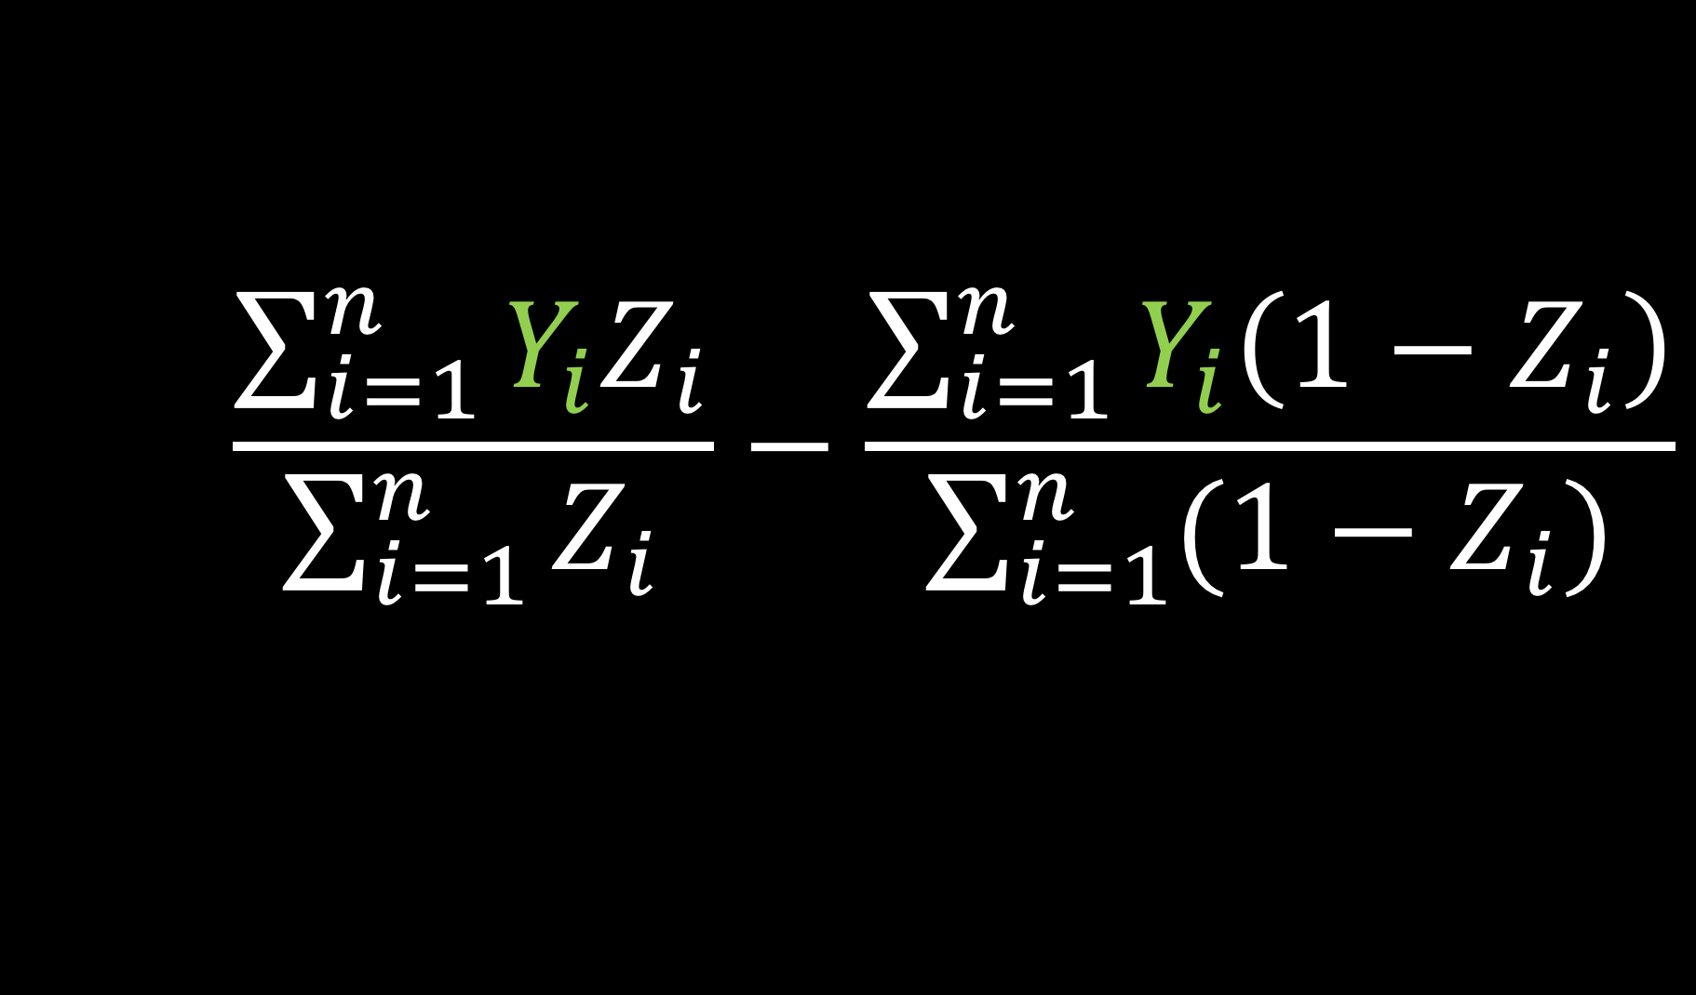
Estimate exposure effect
Notes:
Yi is the observed outcome for participant i

Slide 29
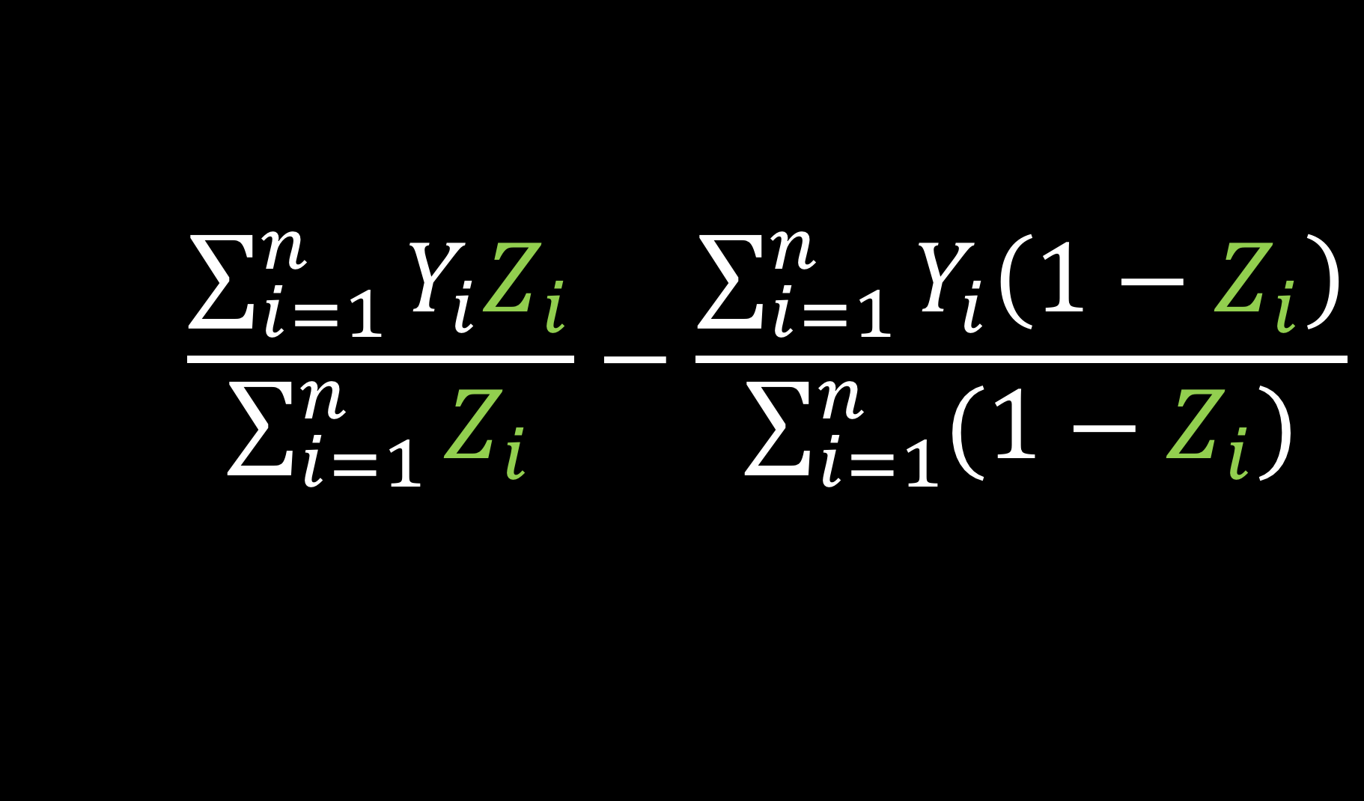
Estimate exposure effect
Notes:
Zi is the indicator for exposure for participant i (it is 0 or 1)

Slide 30
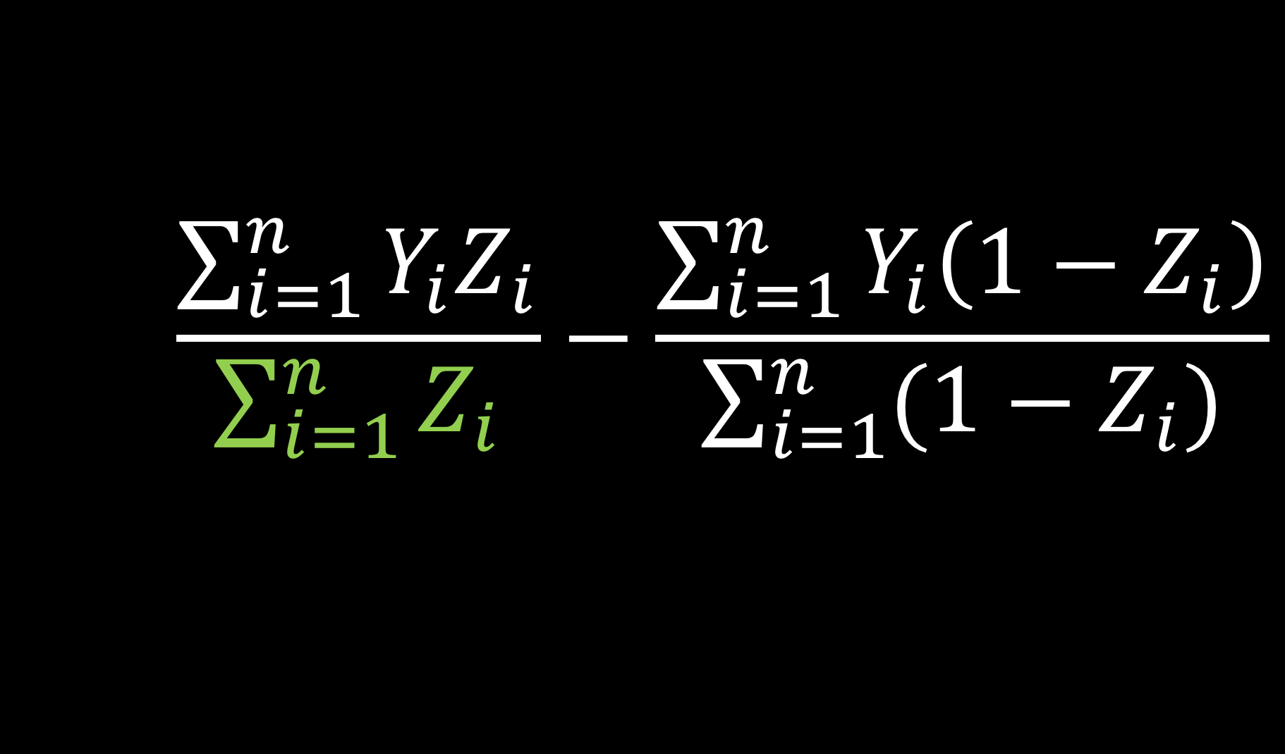
Estimate exposure effect
Notes:
the denominator of this first portion, the sum of Zi, is just your total number of exposed people

Slide 31
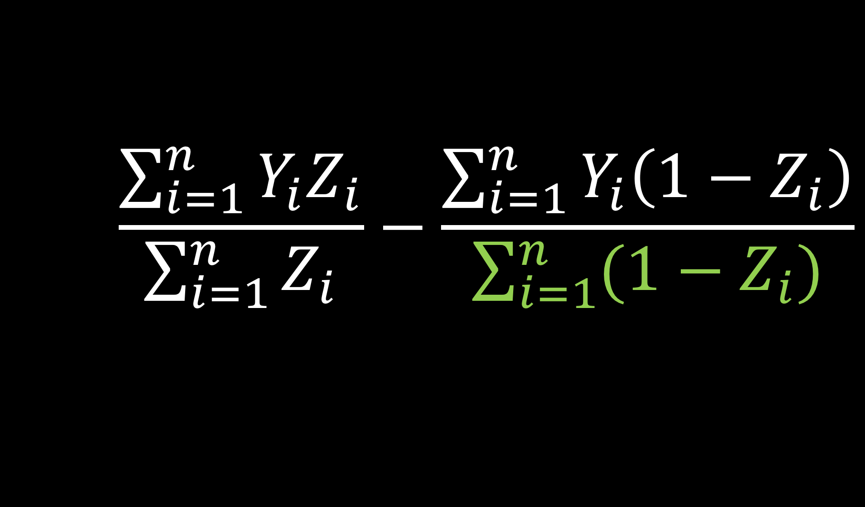
Estimate exposure effect
Notes:
sum of (1-Zi) is your total number of controls

Slide 32
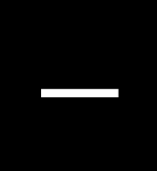
Estimate exposure effect
Average outcome among the exposed
Average outcome among the controls
Notes:
So this is just the average outcome among the exposed [click] minus the average outcome [click] among the unexposed, or control group

Slide 33
Observational Studies
Treatment
P=0.9
Control
P=0.1
Notes:
An observational study differs from a randomized study in that now instead of a random process such as a coin flip determining your treatment assignment, the treatment assignment [click] is determined by something else, for example your doctor. We may still be able to calculate [click] the probability that you were assigned to the treatment group, but it is no longer random. For example, one study I worked on looked at two different diabetes drugs and their association with heart disease. Instead of conducting a randomized trial, we looked at EHR data to see which treatment patients were given and then examined their subsequent heart disease. It turns out one of the drugs was more likely to be prescribed to sicker patients. If we didn't account for this, we would end up with a biased result, it could look like that drug led to more heart disease when in reality this might have been driven by the patients pre-treatment characteristics.

Slide 34
Observational Studies
tidyverse
P=0.9
base R
P=0.1
Notes:
Another example of an observational study is one I'm hoping to implement in the future. This one would examine the best way to teach students interested in pursing a career in data science the software language R. There is a new suite of R packages, known as the tidyverse, that contains tools for data analysis. These tools are much more opinionated or rigid than implementing the same techniques using just the base R software without any packages. To me, it's akin to using software like SAS or Stata, where there are really recipes for completing certain types of analyses. So there is a bit of debate over whether we can jump in and teach students this suite of packages prior to teaching them the fundamentals of R programming. This question has been raised multiple times, but hasn't been formally tested. Since it is challenging to randomly assign students to learn using a different paradigm, we could collect data on how students DID learn and attempt to adjust for pre-exposure characteristics to allow us to draw inference on which of these methods yields a more successful data scientist, another metric that we'd have to define. For example, students who decide to learn base R first may be more likely to understand statistical concepts, and if we didn't adjust for this it could look like teaching base R is preferable. SO these are just some examples of observational studies that have been or can be conducted

Slide 35
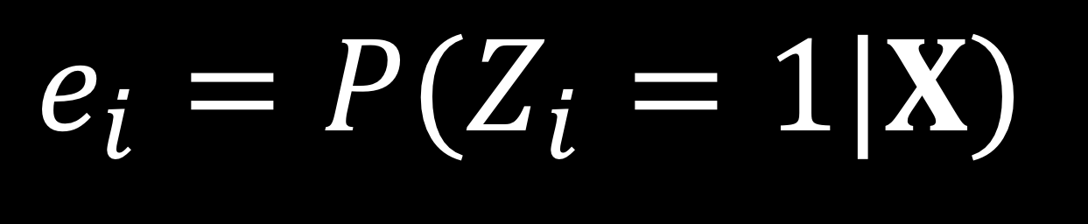
Propensity score
Notes:
SO the main challenge with these observational studies is that there is non-random treatment assignment. One way to account for this non random treatment assignment is via propensity scores. The propensity score is denoted here as ei. It is the probability that you received treatment, or whatever the exposure of interest is, given your observed pre-treatment or pre-exposure, covariates, here denoted as x. A lot of times we fit this with a logistic regression

Slide 36
Propensity scores
Rosenbaum and Rubin showed in observational studies, conditioning on propensity scores can lead to unbiased estimates of the exposure effect
There are no unmeasured confounders
Every subject has a nonzero probability of receiving either exposure
Notes:
Propensity scores can give unbiased estimates of the treatment effect as long as [click] there are no unmeasured confounders - that is you account for all of the pre-treatment characteristics that are associated with both the exposure and the outcome and [click] Every subject has a non-zero probability of receiving either treatment. In other words, you don't want the propensity score to be exactly 0 or 1.

Slide 37
Propensity scores
Rosenbaum and Rubin showed in observational studies, conditioning on propensity scores can lead to unbiased estimates of the exposure effect
There are no unmeasured confounders
Every subject has a nonzero probability of receiving either exposure
Notes:
For this first assumption, there is no way to actually test this, but sensitivity analyses can be done to assess how much an unmeasured confounder could influence your final result.

Slide 38
Propensity scores
Rosenbaum and Rubin showed in observational studies, conditioning on propensity scores can lead to unbiased estimates of the exposure effect
There are no unmeasured confounders
Every subject has a nonzero probability of receiving either exposure
R 📦: tipr
Notes:
As a brief aside, to perform these sensitivity analyses, I have created an R package called tipr, named because it allows you to perform tipping point sensitivity analyses, that is currently on CRAN

Slide 39
Propensity scores
Notes:
Alright so I've shown how that works mathematically, let's take a second to see it visually. [click] I have some exposure here in green. There are [click] 8 participants in this exposure group. Then I have some participants that were [click] not exposed, the control group here in purple. There are [click] 13 people in this group. These participants have pre-treatment or pre-exposure characteristics. In the simplest case, let’s say we just know one characteristic.

Slide 40
Propensity scores
3
2
Notes:
For example, let’s say we know that [click] 3 of the exposed participants smoked prior to the exposure, and [click] two of our control participants smoked prior to the study.

Slide 41
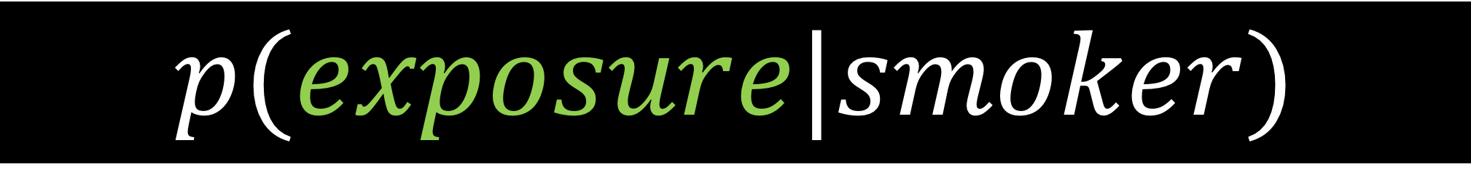
Propensity scores
3
2
Notes:
The propensity score here is going to be the probability of being in the exposed group given the participant’s smoking status

Slide 42
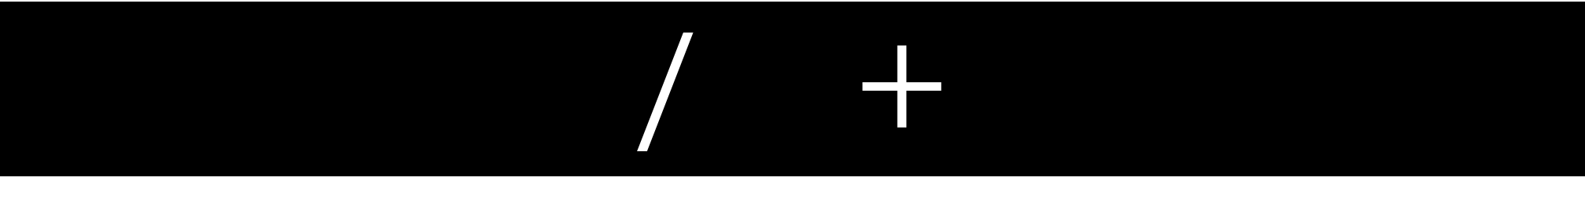
Propensity scores
3
3
2
Notes:
So for the smokers, that would be [click] 3 over 3 + 2

Slide 43
Propensity scores
0.6
0.6
0.4
0.4
0.4
0.6
0.4
0.4
0.4
0.6
0.4
0.4
0.6
0.4
0.4
0.4
0.4
0.4
0.4
0.4
0.4
Notes:
Or 0.6. and for the non-smokers it will be one minus that, 0.4

Slide 44
Propensity scores
Notes:
In reality, rather than knowing just one characteristic about participants, we often know many

Slide 45

Propensity scores
0.9
0.2
0.1
0.3
0.7
0.3
0.1
0.6
0.6
0.9
0.2
0.2
0.3
0.1
0.1
0.8
0.7
0.7
0.8
0.2
0.2
Notes:
Notice these participants all have various combinations of pre-treatment characteristics. For example, some are wearing cowboy hats, some smokers, some have healthy hearts, and some are mustachioed. Using these pre-treatment characteristics, I can calculate the probability that these participants would have received treatment [click], and assign each their propensity score

Slide 46
To Do:
✓
Define propensity score
Define propensity score weight
Show our doubly robust estimator
Define these new weights
Refute some
claims
Wake Forest University Seminar

Slide 47
To Do:
✓
Define propensity score
Define propensity score weight
Show our doubly robust estimator
Define these new weights
Refute some
claims
Wake Forest University Seminar

Slide 48
Propensity scores
0.9
0.2
0.1
0.3
0.7
0.3
0.1
0.6
0.6
0.9
0.2
0.2
0.3
0.1
0.1
0.8
0.7
0.7
0.8
0.2
0.2
Notes:
We then want to use these propensity scores so we can estimate how the exposure is related to the outcome.

Slide 49
Propensity scores
0.9
0.2
0.1
0.3
0.6
0.6
0.9
0.2
0.3
0.1
0.8
0.7
0.7
0.8
0.2
0.2
Notes:
One way to do this is to match the participants in each group by propensity score

Slide 50
Propensity scores
0.2
0.2
0.3
0.6
0.7
0.8
0.9
0.1
0.1
0.2
0.2
0.3
0.6
0.7
0.8
0.9
Notes:
We can now compare the outcome between the exposed group and the control group in the same way we would in a randomized trial because it's a fair comparison, we know they are balanced on this summary measure, the propensity score, of their pretreatment characteristics

Slide 51
Propensity scores
0.9
0.2
0.1
0.3
0.7
0.3
0.1
0.6
0.6
0.9
0.2
0.2
0.3
0.1
0.1
0.8
0.7
0.7
0.8
0.2
0.2
Notes:
Instead of matching, we can create weights that are some function of the propensity score and the indicator of treatment.

Slide 52
Propensity scores
0.9
0.2
0.1
0.3
0.7
0.3
0.1
0.6
0.6
0.6
0.9
0.2
0.2
0.3
0.1
0.1
0.1
0.7
0.7
0.8
0.7
0.2
0.8
0.2
0.8
0.2
0.2
Notes:
Now instead of dropping participants that don't have a good match

Slide 53
Propensity scores
0.9
0.2
0.1
0.3
0.7
0.3
0.1
0.6
0.6
0.9
0.2
0.2
0.3
0.1
0.1
0.8
0.7
0.7
0.8
0.2
0.2
Notes:
We can [click] upweight or down weight participants so the two groups are comparable. SO now we can estimate that treatment or exposure effect in an unbiased way, because again due to the weighting we are balanced on this summary measure of pretreatment characteristics

Slide 54
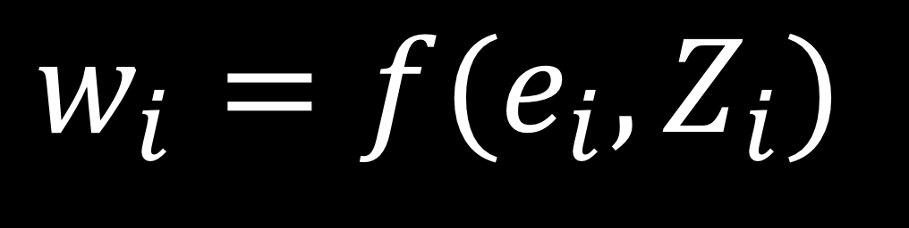
Propensity score
Notes:
Here is what that looks like mathematically. The weight here, wi, is a function of the propensity score, ei and the exposure, Zi

Slide 55
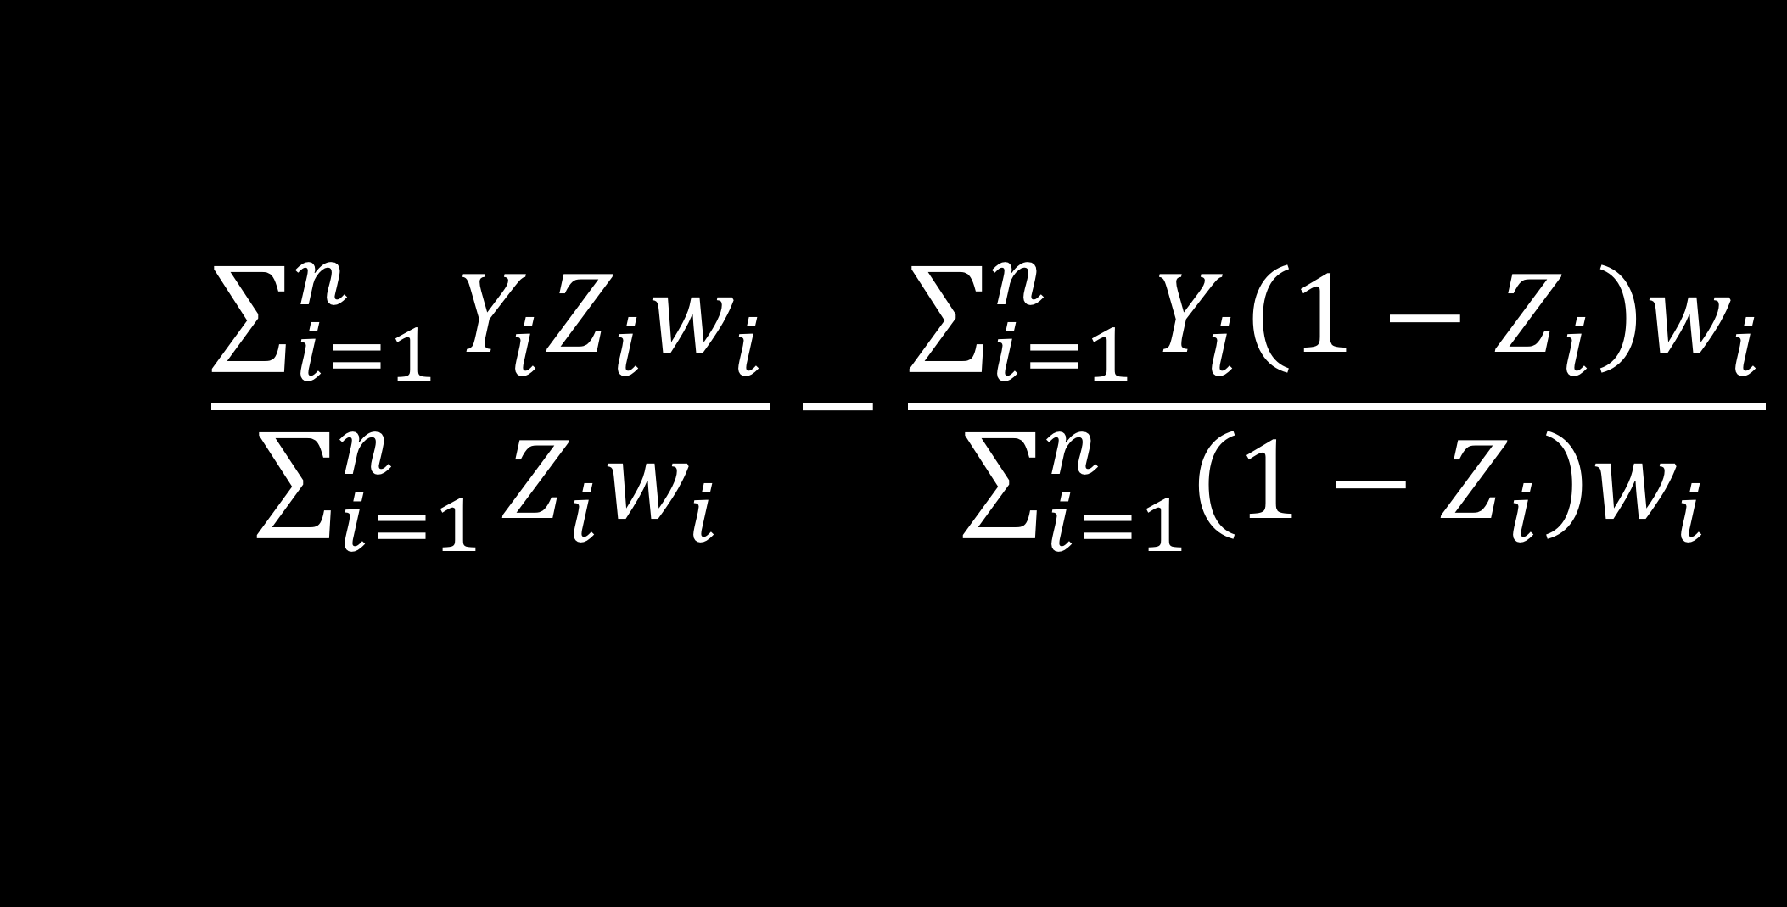
Estimate exposure effect
Notes:
We can incorporate these weights to estimate the treatment effect.

Slide 56
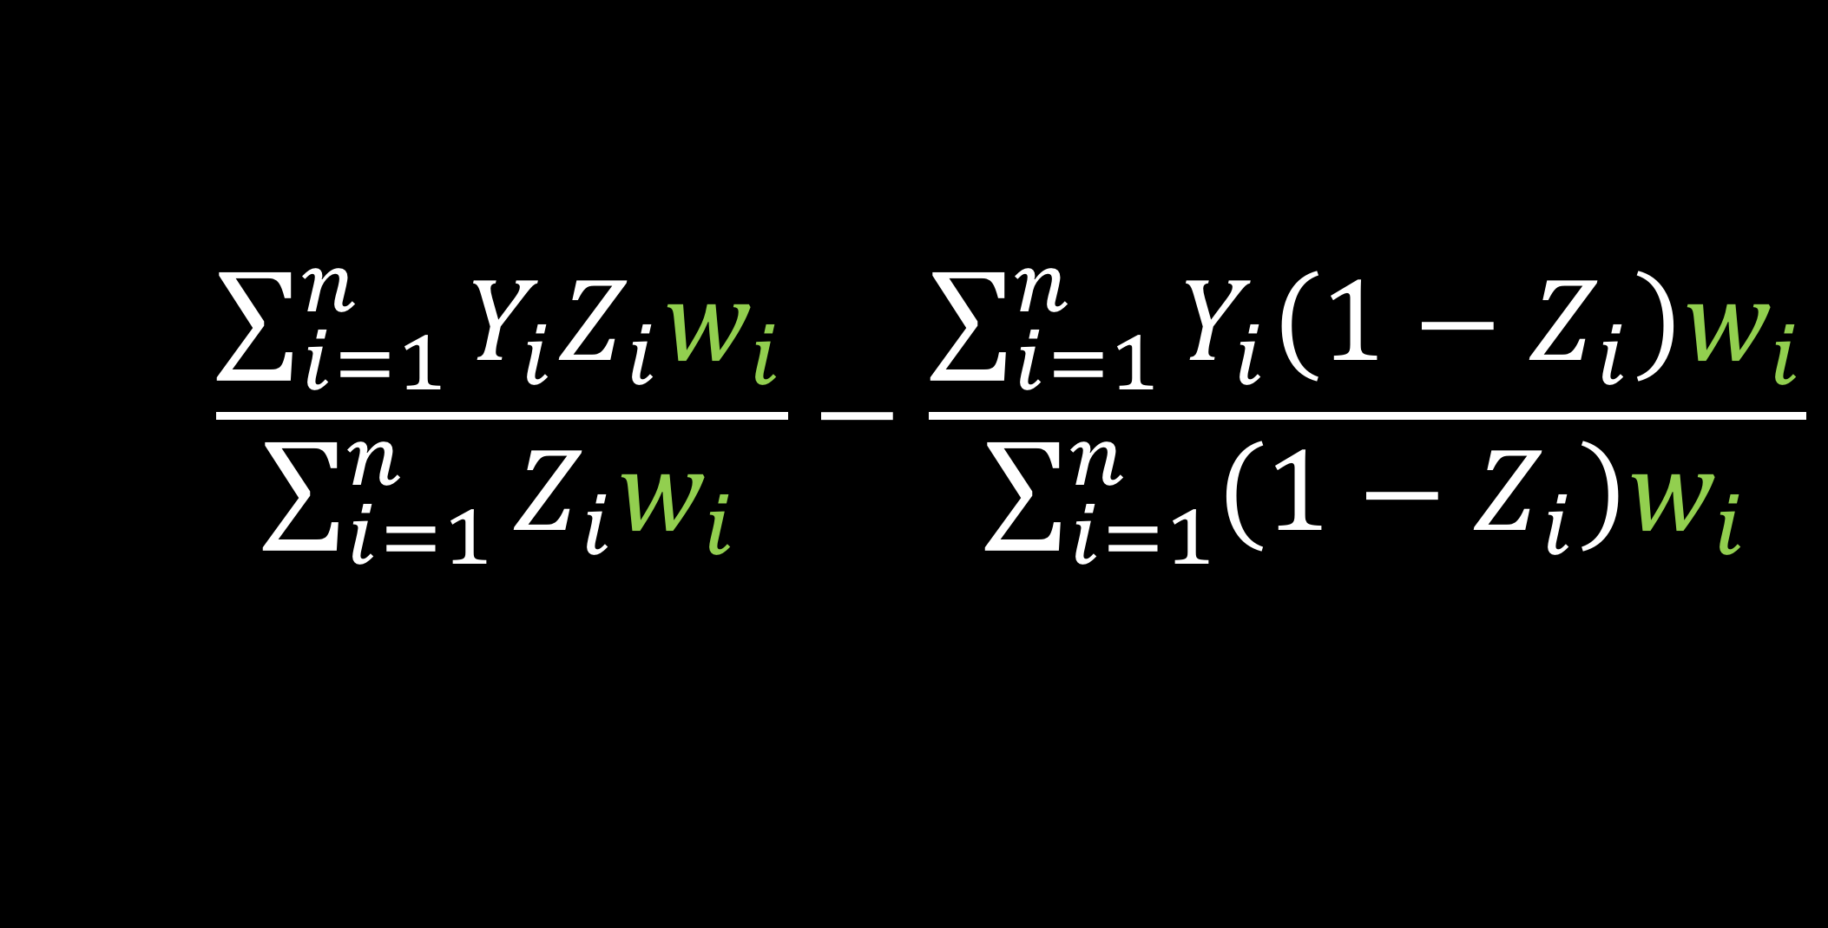
Estimate exposure effect
Notes:
This is a consistent estimator of the exposure effect as long the propensity score is correct, that is we've measured all of the pre-treatment characteristics that are associated with both the exposure and the outcome

Slide 57
Weighting
ATE Average treatment effect
ATO Average treatment effect among the overlap population
Notes:
The two weights we are going to talk about here are ATE weights, or average treatment effect weights. These are a more traditional, or older weighting scheme. and ATO weights, or average treatment effect among the overlap population. These are the new weights that my contributions are based on. I will define these in detail soon, but I just want to get the acronyms out there so you can follow along from here. I've put these along with their definitions on your handout, so you can refer to that if you forget, or feel free to stop me if an acronym is unclear.

Slide 58
To Do:
✓
Define propensity score
✓
Define propensity score weight
Show our doubly robust estimator
Define these new weights
Refute some
claims
Wake Forest University Seminar

Slide 59
To Do:
✓
Define propensity score
✓
Define propensity score weight
Show our doubly robust estimator
Define these new weights
Refute some
claims
Wake Forest University Seminar

Slide 60
We want to use a propensity score model and also adjust the outcome model
Notes:
As I mentioned, the freedman and berk paper we are trying to refute used what is known as a "doubly robust" estimator for the exposure effect. And what this means, is they want to use a propensity score model AND adjust an outcome model

Slide 61
Estimate exposure effect
Notes:
Recall our estimate of the exposure effect that incorporated the propensity score weights

Slide 62
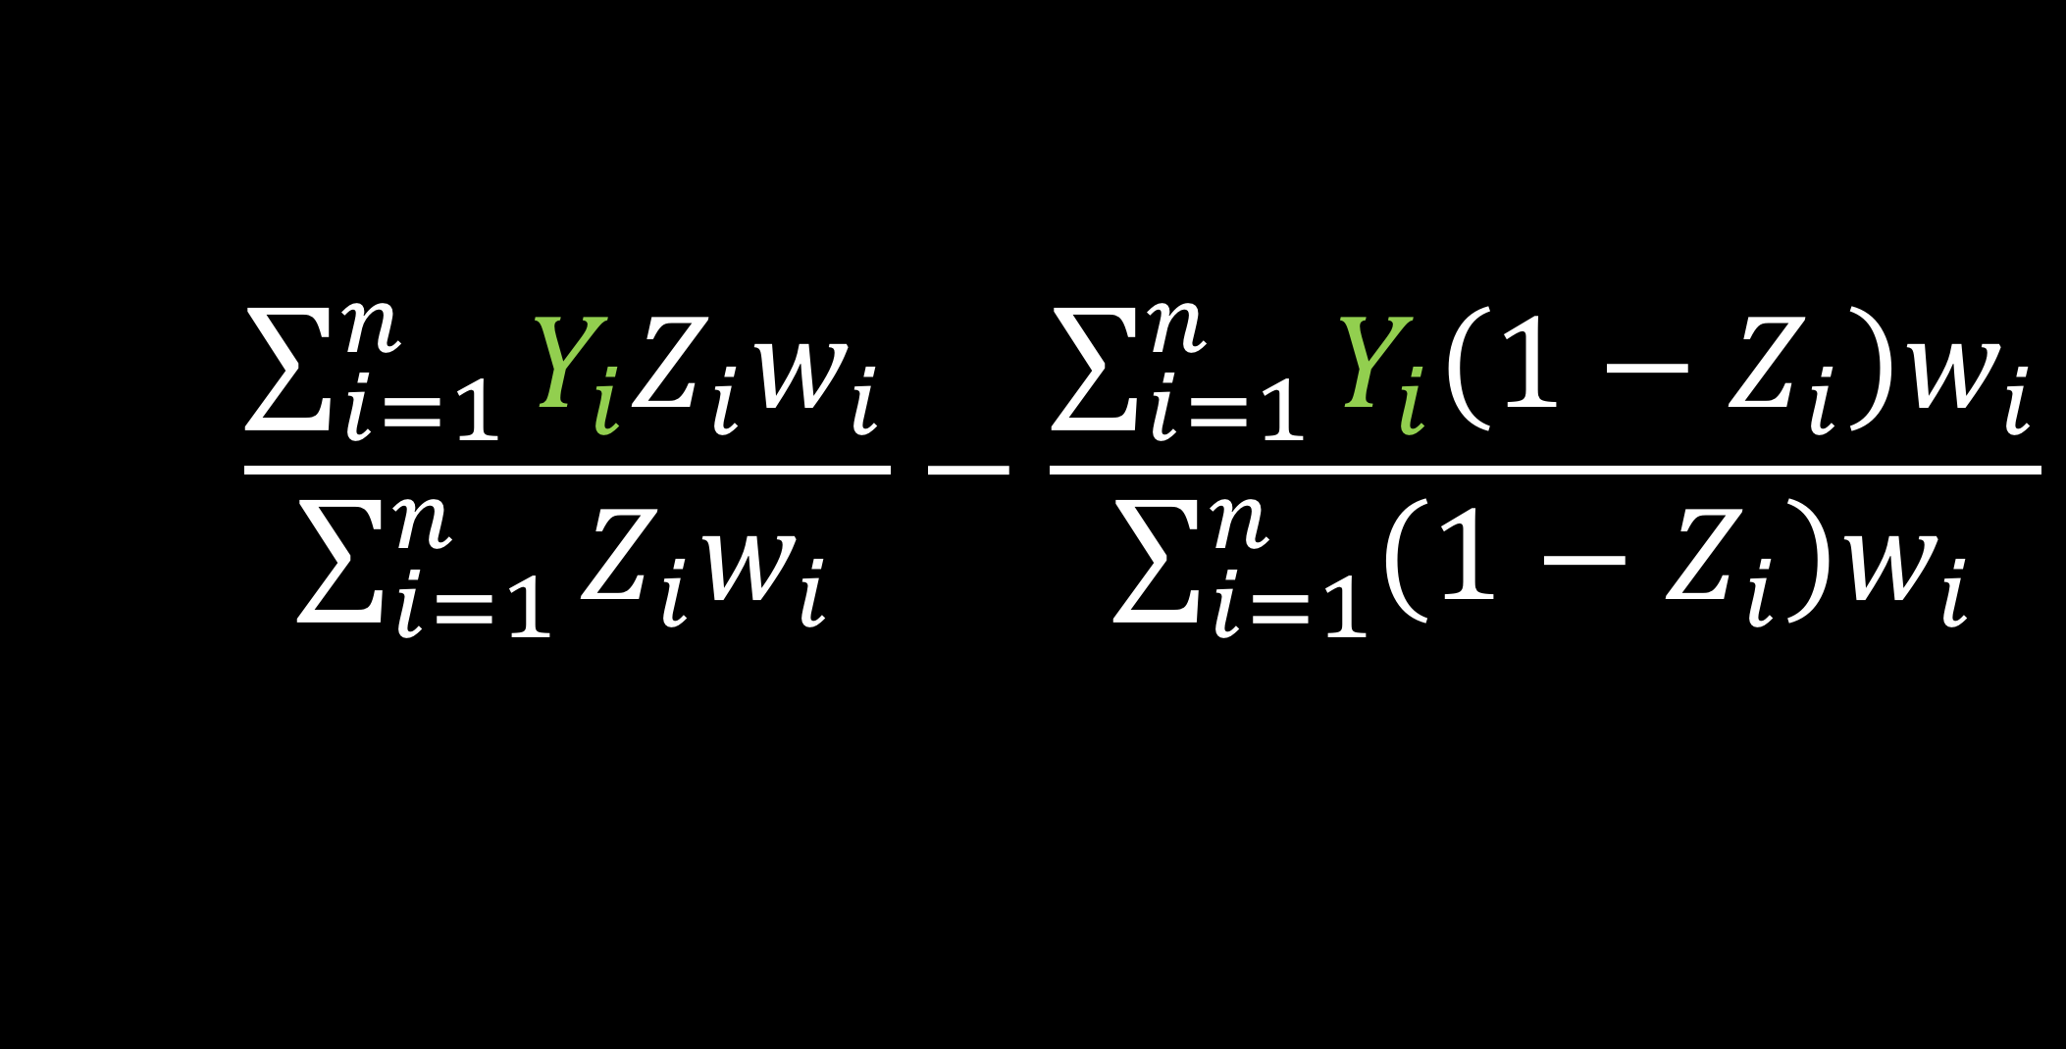
Estimate exposure effect
Notes:
Here, we use the actual observed outcome, but what if we wanted to use an adjusted outcome?

Slide 63
Doubly robust estimators
Fit a propensity score model
Fit two outcome models
Use these to estimate an average treatment effect
As long as one is correctly specified, your result will be consistent
Notes:
That is where doubly robust estimation comes in. [click] to do this we first fit the propensity score model [click] then we fit two outcome models, one among the exposed and one among the control group [click] we use these to estimate the treatment effect [click] As long as ONE is correctly specified your result will be consistent

Slide 64
Doubly robust estimators
Fit a propensity score model
Fit two outcome models
Use these to estimate an average treatment effect
As long as one is correctly specified, your result will be consistent
Notes:
So this means you either have to correctly specify the propensity score model OR correctly specify the outcome model in order to get an unbiased result (consistent here means that with unlimited data we’d get to the truth, or an unbiased estimate)

Slide 65
Doubly robust estimators
Lunceford and Davidian (2004) derived a consistent estimator for the ATE
We derive a consistent estimator for the ATO

Slide 66
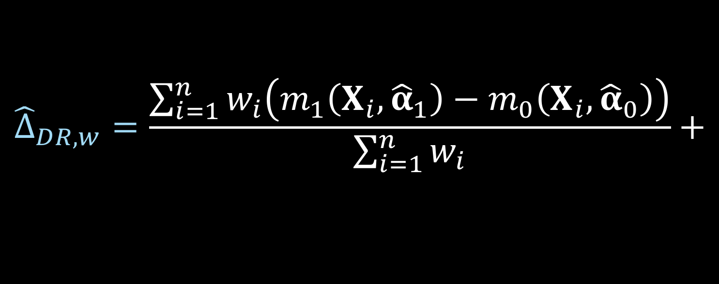
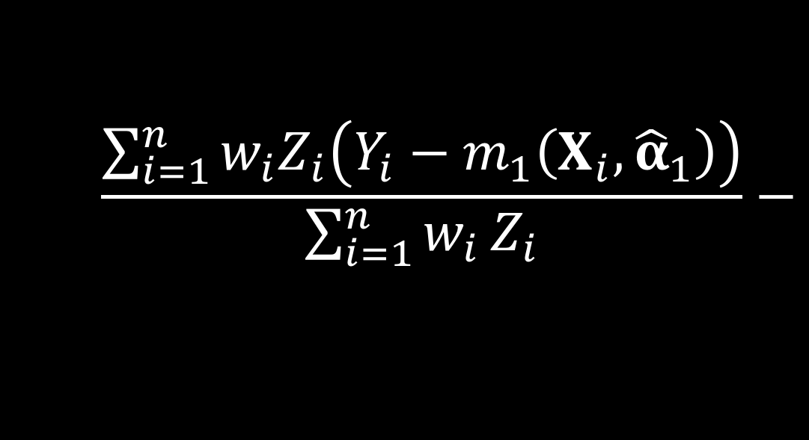
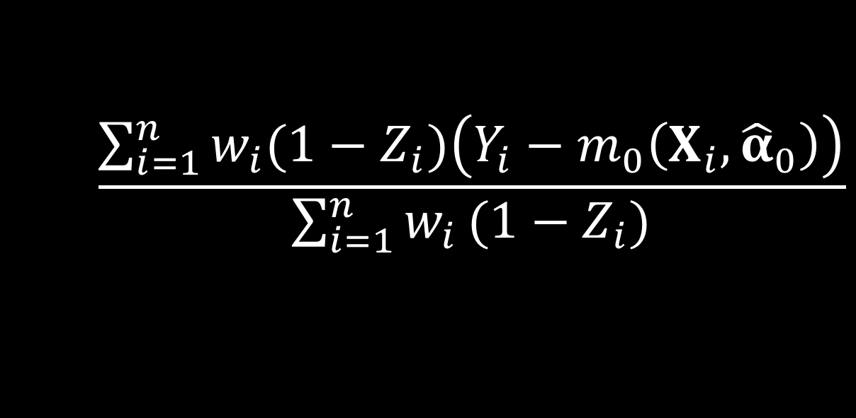
Doubly robust estimator
Notes:
Consistent if either the propensity score model is correct or outcome

Slide 67
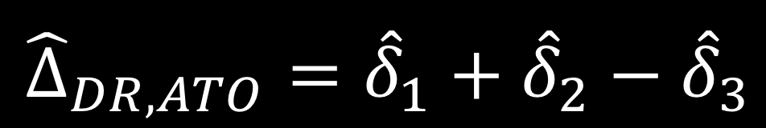
ATO DR estimator
D’Agostino McGowan (2018) Thesis.
Notes:
We can write the doubly robust estimator for the ATO in 3 equations, delta 1, delta2 and delta 3

Slide 68
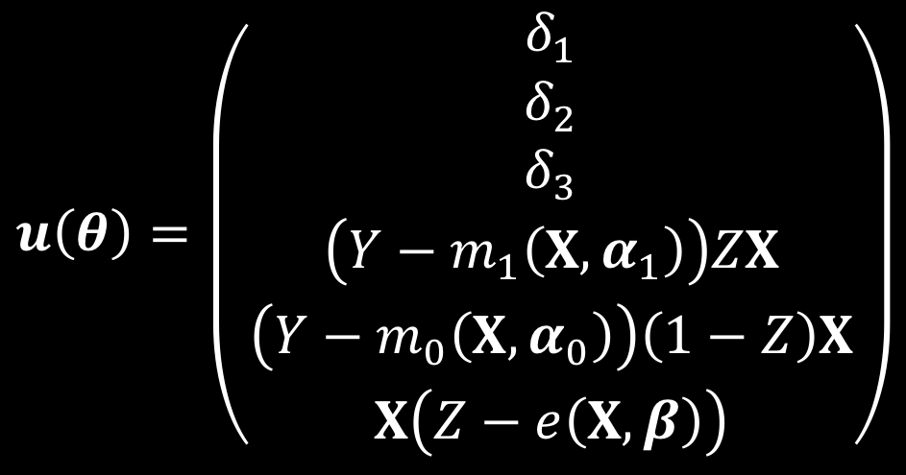
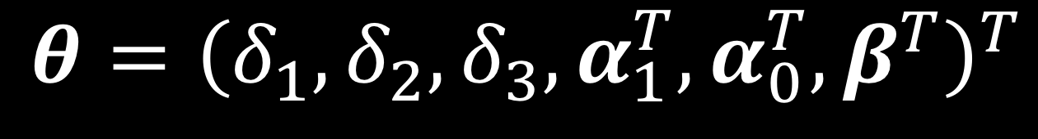
ATO DR estimator
D’Agostino McGowan (2018) Thesis.
Notes:
This can be solved by simultaneously solving these estimating equations where we have 6 parameters. The first three are the components of the doubly robust estimator, the fourth accounts for fitting the outcome model among the treated, the next is for fitting the outcome model among the controls, and the final equation accounts for fitting the propensity score model

Slide 69
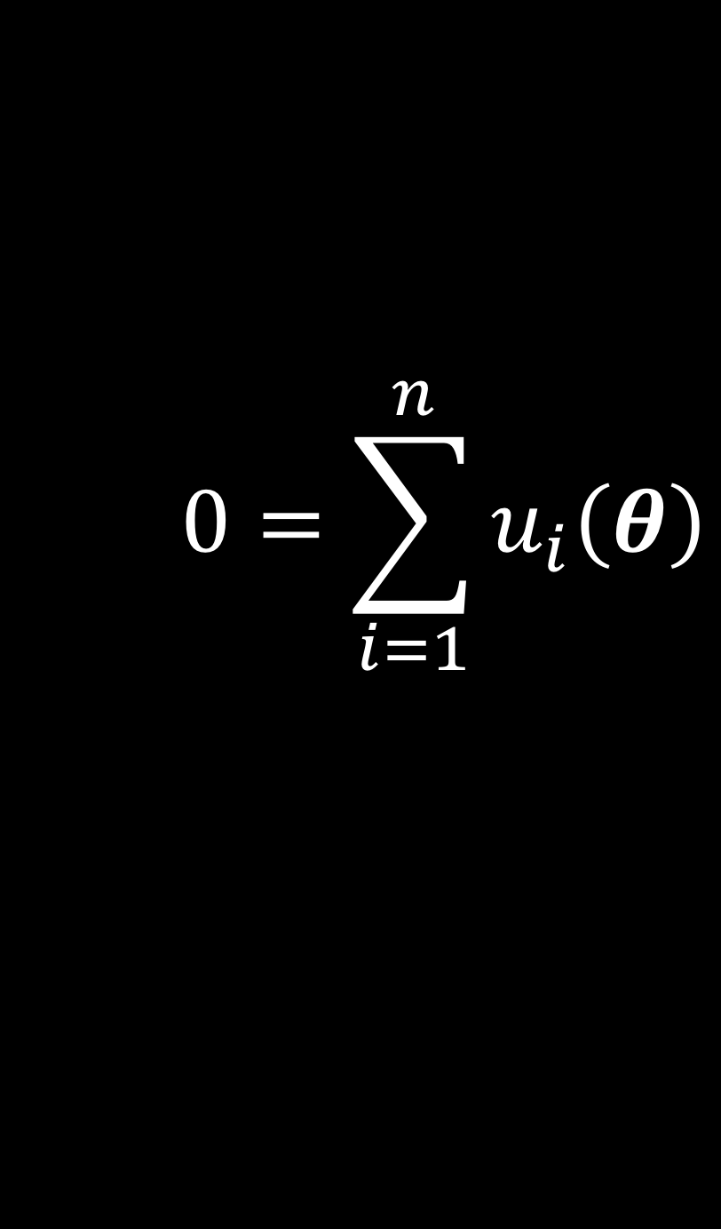
ATO DR estimator
D’Agostino McGowan (2018) Thesis.
Notes:
We can set this equal to 0 and solve for each of the parameters of interest simultaneously

Slide 70
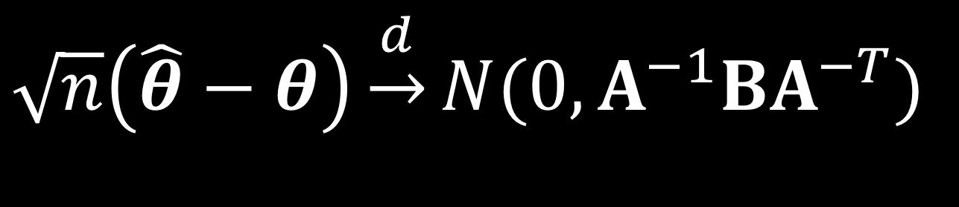
M-Estimation
D’Agostino McGowan (2018) Thesis.
Notes:
Since these estimating equations are unbiased, U of theta is an example of an M-estimator. The asymptotic distribution of an M estimator is the following.

Slide 71
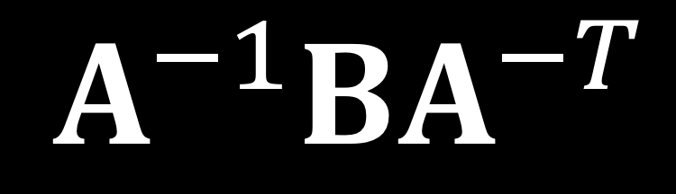
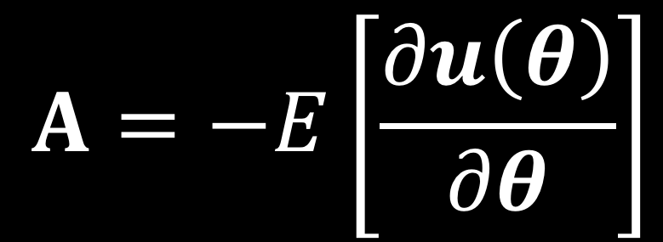
Sandwich estimator
D’Agostino McGowan (2018) Thesis.
Notes:
A is the model-based estimate, the negative expectation of the derivative of u of theta

Slide 72
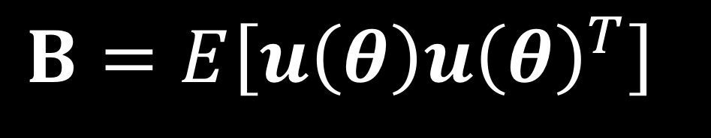
Sandwich estimator
D’Agostino McGowan (2018) Thesis.
Notes:
And then B is the variance of the score function, the expectation of u times u transpose

Slide 73
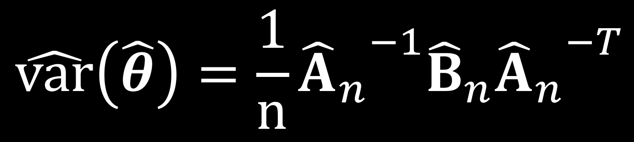
Sandwich estimator
D’Agostino McGowan (2018) Thesis.
Notes:
We can replace the expectations by the sample average to get an approximate large sample variance

Slide 74
To Do:
✓
Define propensity score
✓
Define propensity score weight
✓
Show our doubly robust estimator
Define these new weights
Refute some
claims
Wake Forest University Seminar

Slide 75
To Do:
✓
Define propensity score
✓
Define propensity score weight
✓
Show our doubly robust estimator
Define these new weights
Refute some
claims
Wake Forest University Seminar

Slide 76
Weighting
ATE Average treatment effect
ATO Average treatment effect among the overlap population
Notes:
Here are the weights we are talking about again. There are many different potential weighting schemes based on the target population, or causal estimand, you are interested in. For this talk, we are going to talk about two, a classic weighting scheme for the Average treatment effect and a newer weighting schemes the average treatment effect among the overlap population.

Slide 77
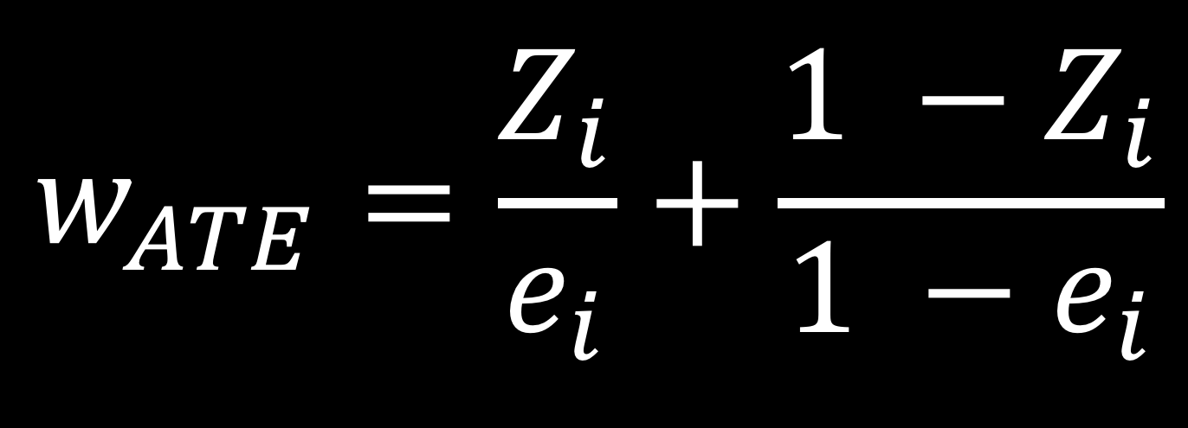
Average treatment effect
Notes:
The first weight we are going to discuss allows you to estimate the average treatment effect. The target population here is the whole sample population, both treated and controlled. If we were to look at a table of pre-treatment characteristics of the patients before and after weighting, post weighting the characteristics would be balanced across treatment groups and would match that of the overall population. For example, if the average age overall in the cohort was 50, with the average age pre-weighting as 40 in the control group and 60 in the treatment group, post weighting the average age in the treatment group and control group would both match the overall unweighted average of 50. So basically you're pulling the covariates in your treatment and control groups to match the distribution of covariates in the overall population.
While this is often declared as the population of interest because it lets you estimate what the treatment effect would be in the overall population, it is not always the medically or scientifically appropriate population. This is because estimating the ATE assumes that every participant can be switched from their current treatment to the opposite, which doesn’t always make sense. For example, it may not be medically appropriate for every participant who didn’t receive a treatment to receive it. I'm going to briefly step through this equation to give some intuition about what this weight is doing, and then show the pseudo population created when using this weight

Slide 78
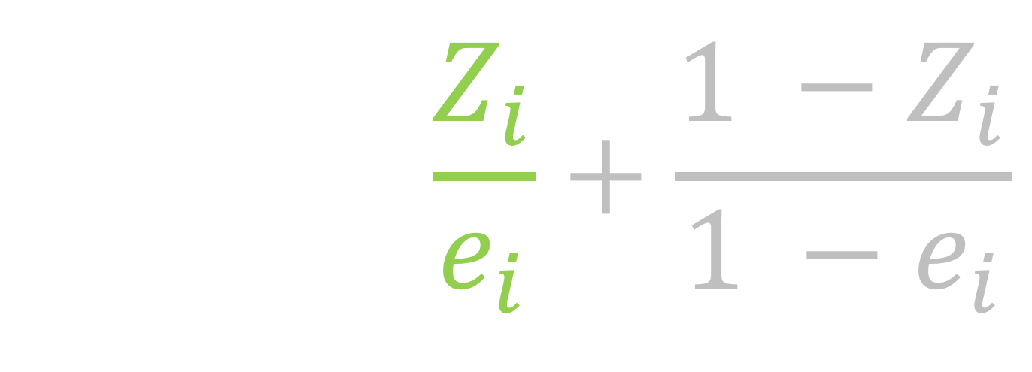
Average treatment effect
Notes:
participants who receive treatment will just have this part of the equation, since Zi is 1, making the second part 0. For these participants there weight is just 1 over their propensity score

Slide 79
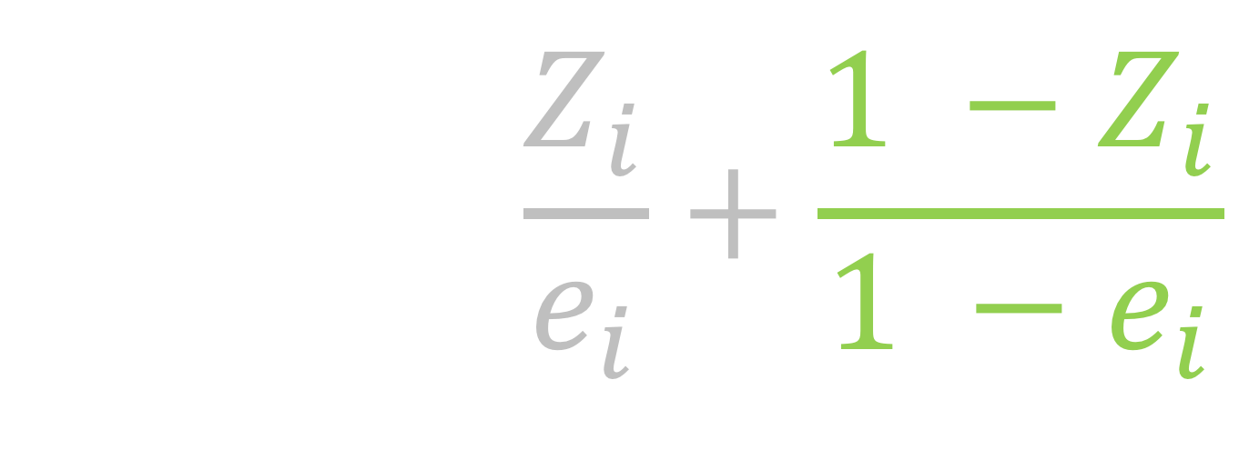
Average treatment effect
Notes:
the participants in the control group, will just have this part of the equation. Their weight will just be 1 over 1 minus the propensity score. So these ATE weights overall are just 1 over the probability of receiving the treatment that you received. An important thing to notice here is these weights range from 1 to infinity, so in theory they can be very very large

Slide 80
treatment
control
0.99
Notes:
Here, I have a mirrored histogram of the propensity scores of the actual observed sample. On the top, above 0, I have the histogram of propensity scores among the treated. Notice here that the graph is skewed such that most of the mass is on the higher end. This makes sense since the propensity score is the probability of receiving treatment, we'd expect those who DID receive treatment to have often been more likely to do so. For example [click]here we one participant in the far end of the control group. They have a propensity score greater than 0.99. And above them, in the treatment group, we have about 24 participants that also have a propensity score greater than .99. Now let's look at the other side, the mirrored histogram below 0. This is the histogram of propensity scores for the control group. Here, there is more mass towards 0, since these participants were more likely to NOT receive the treatment. Also notice that it looks like we have more participants in the treatment group than the control group. The ATE weights are trying to make these two populations look similar, it wants them to look like the overall population. We would expect that we will need to upweight some of these control patients on the higher side of the propensity scores, and upweight some of these treated participants on the low side of the propensity scores.

Slide 81
trt
control
Notes:
This is the same histogram as the previous slide, I've just shrunk it a bit to extend the y-axis so we can see the pseudo-population created from the ATE weights

Slide 82
trt
control
Notes:
The dark portion, the grey, are the distribution of propensity scores and again the top part of the mirrored histogram is the treated population and the bottom, the upside-down histogram is the control population. Then the green represents the weighted population for the treated and the blue is the weighted population for the controls.
In other words, the green and blue represent the pseudo population created by using the weights (Frequency counts for a pseudo population based on the weights) [click] This guy at the far end has a propensity score greater than .99, and therefore ends up accounting for [click]151 people in the pseudo cohort.

Slide 83
trt
control
Notes:
Then these 24 participants in the treatment group end up with weights around 1, so they each represent [click] 1 person in the pseudo-population

Slide 84
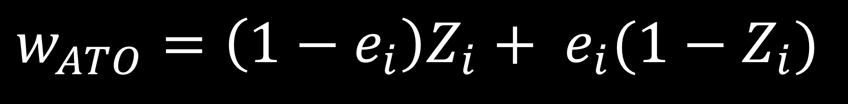
Average treatment effect among the overlap population
Li et al (2016)
Notes:
Here are the overlap weights. These were derived by Li et al in 2016 estimate the average treatment effect among the overlap population. Here, we are constructing a pseudo-population that will have the most overlap in the covariate space between treatment groups. In practice, this creates a cohort often very similar to a matched cohort, with some improved variance properties. Here the weight is 1 minus the propensity score for the treated and the propensity score for the controls. So this is going to be bounded by 0 and 1, making it more stable

Slide 85
treatment
control
Notes:
Here is what that pseudo population looks like. [click] Now this one person in the control group, has a weight around 1 rather than 151, so they just represent [click] one person in the pseudo population. Up here, our [click] 24 treated participants now have weights of around 0.01, [click]they now are significantly down-weighted in this new pseudo population

Slide 86
ATE
AT0
Notes:
Here are the two pseudo-populations side by side so you can get a better idea for the difference, with those ATE weights causing the population to increase, potentially blowing up in the tails, and the ATO weights attenuating the population, making it more stable than the ATE weighted group.

Slide 87
To Do:
✓
Define propensity score
✓
Define propensity score weight
✓
Show our doubly robust estimator
✓
Define these new weights
Refute some
claims
Wake Forest University Seminar

Slide 88
Notes:
This work was motivated in part by a paper that came out in 2008 by Freedman and Berk. This paper stated that [click, read].

Slide 89
Propensity score weighting
Bias
Variance
Notes:
Two things we DO NOT want in statistics are increased bias and increased variance. According to this paper, [click] propensity score weighting does BOTH! It increases [click] bias and [click] increases the variance. So based on this paper alone, I would say [click] NO don’t use propensity score weighting! But maybe that isn’t the full story

Slide 90
Bias
Variance
Notes:
As a quick reminder, bias measures how far off our estimate is from the truth, for example this target on the left is an example of being unbiased. and variance refers to how precise our estimate is, so the target on the right shows a very precise result

Slide 91
Notes:
According to Freedman and Berk, propensity score weighting leads to results that are BOTH biased and have high variance so…not great.

Slide 92
Propensity score weighting method
The weights used in Freedman & Berk (2008) are estimating ATE
ATE weights can explode
151
Notes:
These are known to be unstable because the weights can range from 1 to infinity

Slide 93
Propensity score weighting method
The weights used in Freedman & Berk (2008) are estimating ATE
ATE weights can explode
Hypothesize that ATO weights will perform better
Notes:
These are known to be unstable because the weights can range from 0 to infinity

Slide 94
Freedman & Berk Simulation
Notes:
Freedman and Berk demonstrated that propensity score weighting introduced bias and large standard errors. In their simulation, they fixed their sample size at 1000. To get a handle on this bias, we examined sample sizes from 100 to 10,000. We know that the propensity score was modeled correctly, and this is a doubly robust estimator, so we would expect the estimate to be consistent, and therefore the bias to reduce as the sample size increases, but the rate at which it is decreasing is definitely of interest. We also introduced this new weighting scheme to see how it fared under these simulated conditions.

Slide 95
x₁
x₂
z
y
Notes:
In this simulation, we have two pre-treatment covariates, x1 and x2. Both are confounders, in other words associated with the exposure, z as well as the outcome y. z, the exposure or treatment variable, is associated with y the outcome variable

Slide 96
Bias
Variance

Slide 97
Fit a misspecified model
Allow the propensity score to be correct
The outcome model is missing a covariate
Notes:
[click][click]This is a doubly robust set up, such that because one of the two models is correct, in this case the propensity score model, we should be getting a consistent result. BUT as we know in statistics, when we say we should get a consistent result, we are often talking about in an infinite sample, which is never the reality. In reality we have finite samples, and these samples can suffer from finite sample bias.

Slide 98
1
x₁
x₂
0.25
2
0.75
1
z
1
y

Slide 99
1
x₁
x₂
0.25
2
0.75
1
z
1
y

Slide 100
1
x₁
x₂
0.25
2
0.75
1
z
1
y

Slide 101
1
x₁
x₂
0.25
2
0.75
1
z
1
y

Slide 102
1
x₁
x₂
0.25
2
0.75
1
z
1
y

Slide 103
Propensity score model
x₁
x₂
z
Notes:
So we fit a propensity score model that is correctly specified, that is has the correct pre-treatment covariates. Because it is correctly specified, we know our treatment effect will be consistent, but it may be biased in finite samples.

Slide 104
Outcome model
x₁
x₂
z
y
Notes:
The outcome model is missing one covariate, x2.

Slide 105
treatment
ctrl
Notes:
Here is a mirrored histogram of this population. Just looking at this, we can see that the ATE weights are going to have some trouble since there are so many more treated than control patients, especially towards the higher end.

Slide 106
ATE pseudo population
treatment
control

Slide 107
ATO pseudo population
treatment
ctrl

Slide 108
Notes:
Let me take a few minutes to explain this graph.

Slide 109
Notes:
Let me take a few minutes to explain this graph.

Slide 110
Notes:
Let me take a few minutes to explain this graph.

Slide 111
n = 1000
Notes:
Let me take a few minutes to explain this graph.
At n = 1000, Freedman and Berk report a bias of 0.13 and we replicate this. Even when n is 10,000, the result is still biased. So they of course were correct, these weights do lead to bias in finite samples.

Slide 112
Notes:
However it turns out to be less of a story about weighting in general, and more of a story about these particular weights.

Slide 113
Bias
Variance
Notes:
As a quick reminder, bias measures how far off our estimate is from the truth, for example this target on the left is an example of being unbiased. and variance refers to how precise our estimate is, so the target on the right shows a very precise result

Slide 114
Fit correctly specified models
Allow the propensity score to be correct
Allow the outcome model to be correct

Slide 115
Propensity score model
x₁
x₂
z
Notes:
So we fit a propensity score model that is correctly specified, that is has the correct pre-treatment covariates. Because it is correctly specified, we know our treatment effect will be consistent, but it may be biased in finite samples.

Slide 116
Outcome model
x₁
x₂
z
y

Slide 117
Notes:
We replicate what Freedman and Berk show, that this difference in the true standard error of these estimates is 0.12.

Slide 118
Notes:
Correct-correct
Minimum variance unbiased estimator

Slide 119
Notes:
So as a recap, when the outcome model is WRONG, using the ATO weights improves the bias [click] so this is a good thing!

Slide 120
Notes:
And when the outcome model is RIGHT there is little sacrifice in terms of variance when using the ATO weights, so the downsides are pretty minimal

Slide 121
Recap
Replicated the finite-sample bias seen by Freedman and Berk using the ATE weights
ATO weights had improved finite-sample properties
The variance for the ATO is preferable to that of the ATE

Slide 122
Further Research
Look into refuting more claims! “two wrong models are not better than one”
What happens when the assumptions are violated?
Apply these techniques to use EHR data to build a control group for clinical trials

Slide 123
Further Research
Look into refuting more claims! “two wrong models are not better than one”
What happens when the assumptions are violated?
Apply these techniques to use EHR data to build a control group for clinical trials

Slide 124
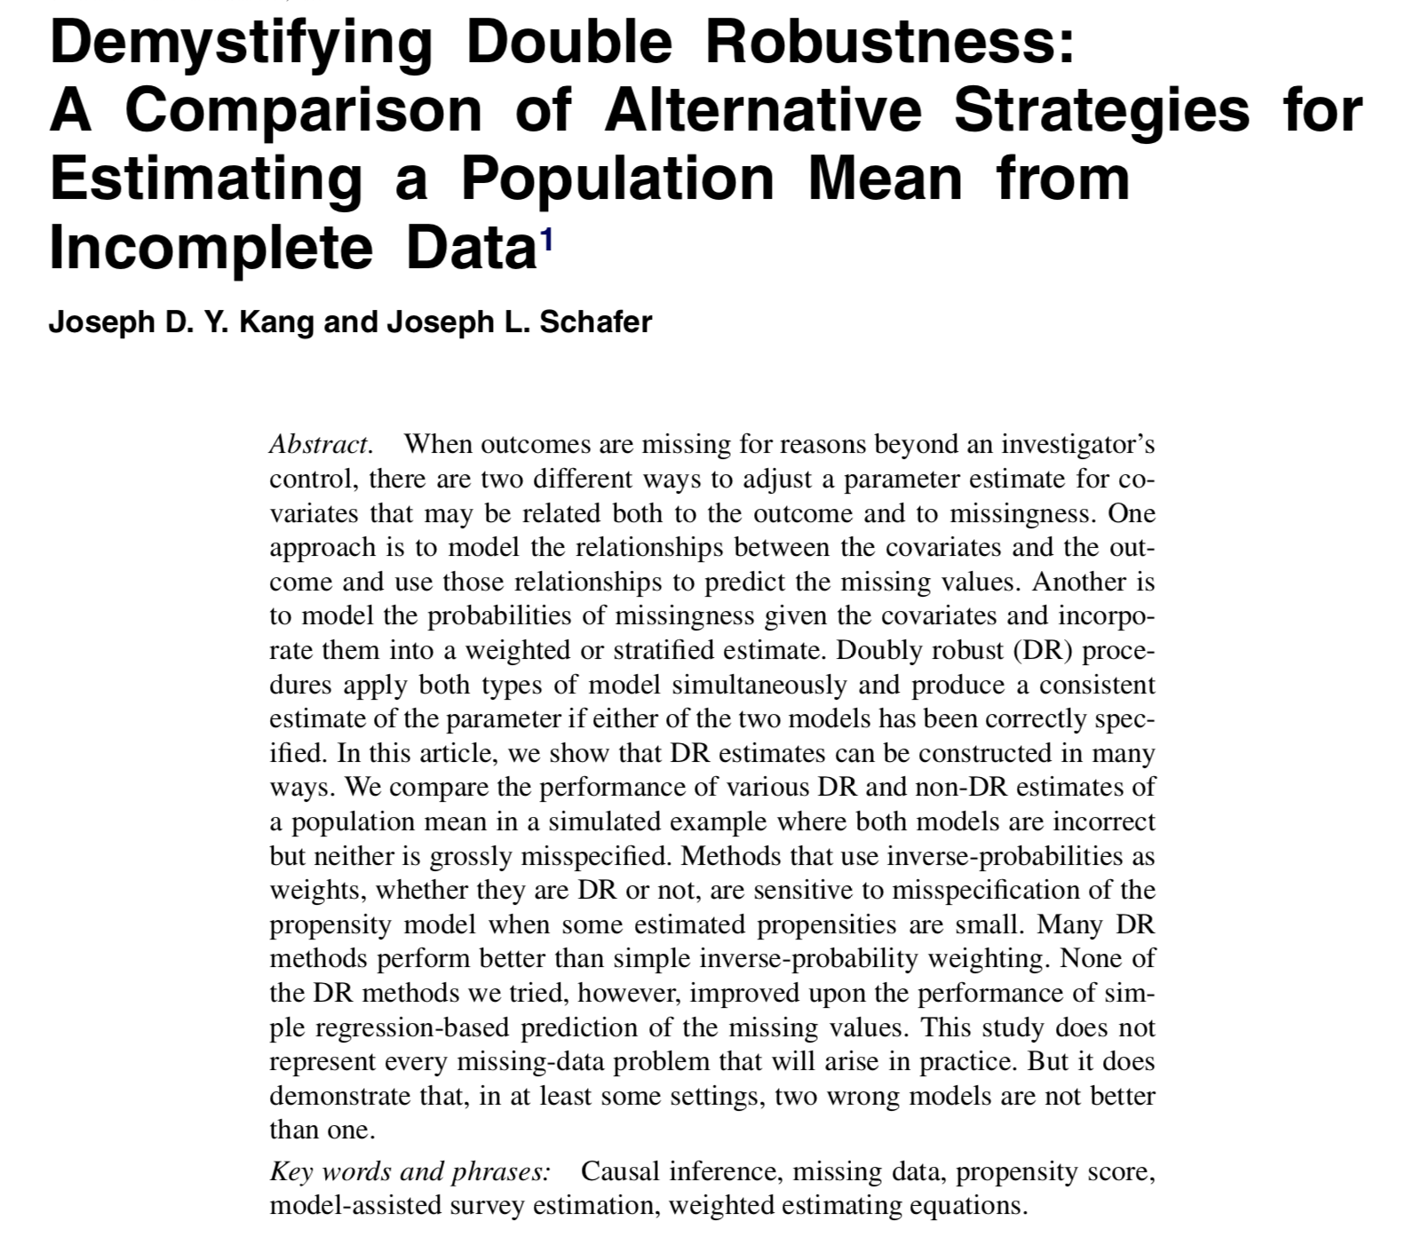
Notes:
There is another famous paper that criticizes double robust estimators by Kang and Schafer from 2007. As we’ve discussed, doubly robust estimators will give a consistent result as long as either the propensity score model or the outcome model are correctly specified. But what if they are both a little wrong? [click] This paper has a famous line "two wrong models are not better than one" It demonstrated that under certain circumstances, if both models are wrong, it is worse than just fitting one wrong model. They were using the ATE weights and a lot of the bias they saw was likely due to the finite sample properties we’ve discussed here. I’d like to investigate whether these newer ATO weights would produce similar results, and I suspect they would not.

Slide 125
Further Research
Look into refuting more claims! “two wrong models are not better than one”
What happens when the assumptions are violated?
Apply these techniques to use EHR data to build a control group for clinical trials

Slide 126
Propensity scores
Rosenbaum and Rubin showed in observational studies, conditioning on propensity scores can lead to unbiased estimates of the exposure effect
There are no unmeasured confounders
Every subject has a nonzero probability of receiving either exposure
Notes:
We discussed previously that the propensity score model is consistent as long as there are no unmeasured confounders

Slide 127
Propensity scores
Rosenbaum and Rubin showed in observational studies, conditioning on propensity scores can lead to unbiased estimates of the exposure effect
There are no unmeasured confounders
Every subject has a nonzero probability of receiving either exposure
R 📦: tipr
Notes:
I mentioned that I have created an R package on CRAN that allows you to do a sensitivity analysis to test how much this assumption is impacting your results. I have been working to further this research and trying to find ways to simplify these sensitivity analyses so they are used more broadly.

Slide 128
Further Research
Look into refuting more claims! “two wrong models are not better than one”
What happens when the assumptions are violated?
Apply these techniques to use EHR data to build a control group for clinical trials

Slide 129
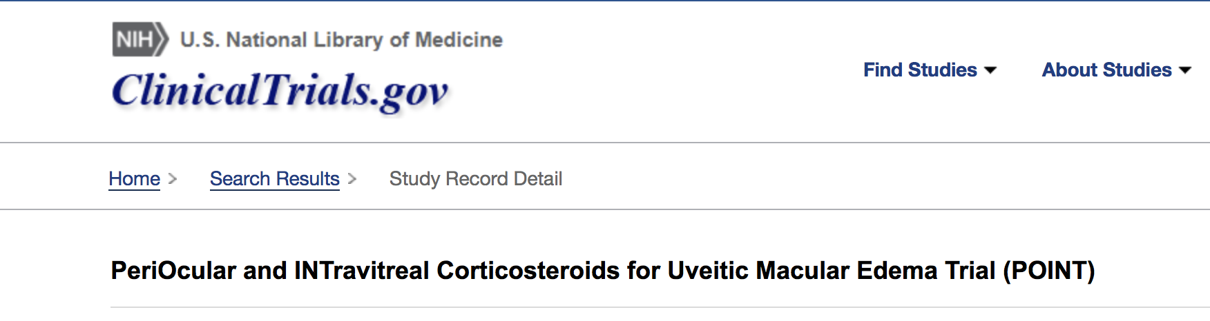
Notes:
In ophthalmology, there is a large observational database called the IRIS registry that is essentially health records for over 41 million unique patients. At Johns Hopkins there is a clinical trial for ophthalmology patients called the “POINT” trial. We have teamed up with both research groups and are working to see if we can create a “control” group from the IRIS data that matches that of the clinical trial. This would allow us to augment clinical trials with observational data. We're trying to use propensity score weighting to this end.

Slide 130
Q&A

Slide 131
References
Austin, Peter C. 2009. “Balance diagnostics for comparing the distribution of baseline covariates between treatment groups in propensity-score matched samples.” Statistics in Medicine 28 (25): 3083–3107.
Austin, Peter C, and Elizabeth A Stuart. 2015. “Moving towards best practice when using inverse probability of treatment weighting (IPTW) using the propensity score to estimate causal treatment effects in observational studies.” Statistics in Medicine 34 (28): 3661–79.
Bang, Heejung, and James M Robins. 2005. “Doubly Robust Estimation in Missing Data and Causal Inference Models.” Biometrics 61 (4): 962–73.
Belle, G. van. 2011. Statistical Rules of Thumb. Wiley Series in Probability and Statistics. Wiley. https://books.google.com/books?id=UaEL-HI6v2YC.
Bross, IDJ. 1966. “Spurious effects from an extraneous variable.” Journal of Chronic Diseases.
Brumback, Babette A, Miguel A Hernán, Sebastien J P A Haneuse, and James M Robins. 2004. “Sensitivity analyses for unmeasured confounding assuming a marginal structural model for repeated measures.” Statistics in Medicine 23 (5): 749–67.
Busso, Matias, John DiNardo, and Justin McCrary. 2009. “Finite sample properties of semiparametric estimators of average treatment effects.” Forthcoming in the Journal of Business and Economic Statistics.

Slide 132
References
———. 2014. “New Evidence on the Finite Sample Properties of Propensity Score Reweighting and Matching Estimators.” Review of Economics and Statistics 96 (5): 885–97.
Connors, A F, T Speroff, N V Dawson, and C Thomas. 1996. “The effectiveness of right heart catheterization in the initial care of critically III patients.” Jama.
Cornfield, J, W Haenszel, E C Hammond, A M Lilienfeld, M B Shimkin, and E L Wynder. 1959. “Smoking and lung cancer: recent evidence and a discussion of some questions.” Journal of the National Cancer Institute 22 (1): 173–203.
Crump, R K, V J Hotz, G W Imbens, and O A Mitnik. 2009. “Dealing with limited overlap in estimation of average treatment effects.” Biometrika 96 (1): 187–99.
Ding, Peng, and Tyler J VanderWeele. 2016. “Sensitivity Analysis Without Assumptions.” Epidemiology (Cambridge, Mass.) 27 (3): 368–77.
D’Agostino, R B. 1998. “Propensity score methods for bias reduction in the comparison of a treatment to a non-randomized control group.” Statistics in Medicine 17 (19): 2265–81.
Freedman, David A, and Richard A Berk. 2008. “Weighting regressions by propensity scores.” Evaluation Review 32 (4): 392–409.

Slide 133
References
Funk, Michele Jonsson, Daniel Westreich, Chris Wiesen, Til Stürmer, M Alan Brookhart, and Marie Davidian. 2011. “Doubly Robust Estimation of Causal Effects.” American Journal of Epidemiology 173 (7): 761–67.
Greenland, Sander. 1998. “The sensitivity of a sensitivity analysis.” 1997 Proceedings of the Biometrics Section American Statistica Association, 19–21.
———. 2001. “Sensitivity Analysis, Monte Carlo Risk Analysis, and Bayesian Uncertainty Assessment.” Risk Analysis 21 (4): 579–84.
———. 2003. “The Impact of Prior Distributions for Uncontrolled Confounding and Response Bias.” Journal of the American Statistical Association 98 (461): 47–54.
———. 2005. “Multiple-bias modelling for analysis of observational data.” Journal of the Royal Statistical Society: Series A (Statistics in Society) 168 (2): 267–306.
Groenwold, Rolf H H, Anna M M Van Deursen, Arno W Hoes, and Eelko Hak. 2008. “Poor Quality of Reporting Confounding Bias in Observational Intervention Studies: A Systematic Review.” Annals of Epidemiology 18 (10): 746–51.
Groenwold, Rolf H H, Frank Vries, Anthonius Boer, Wiebe R Pestman, Frans H Rutten, Arno W Hoes, and Olaf H Klungel. 2011. “Balance measures for propensity score methods: a clinical example on beta-agonist use and the risk of myocardial infarction.” Pharmacoepidemiology and Drug Safety 20 (11): 1130–7.

Slide 134
References
Hansen, Ben B, and Mark M Fredrickson. 2014. “Omitted Variable Sensitivity Analysis with the Annotated Love Plot.” Society for Research on Educational Effectiveness.
Hosman, C A, B B Hansen, and P W Holland. 2010. “The Sensitivity of Linear Regression Coefficients’ Confidence Limits to the Omission of a Confounder.” The Annals of Applied Statistics.
Hsu, Jesse Y, and Dylan S Small. 2013. “Calibrating Sensitivity Analyses to Observed Covariates in Observational Studies.” Biometrics 69 (4): 803–11.
Imai, K, G King, and E A Stuart. 2008. “Misunderstandings between experimentalists and observationalists about causal inference.” Journal of the Royal Statistical Society ….
Imbens, Guido W, and Donald B Rubin. 2015. Causal Inference in Statistics, Social, and Biomedical Sciences. Cambridge University Press.
Imbens, Guido W, and Jeffrey M Wooldridge. 2009. “Recent Developments in the Econometrics of Program Evaluation.” Journal of Economic Literature 47 (1): 5–86.
Joffe, Marshall M, Thomas R Ten Have, Harold I Feldman, and Stephen E Kimmel. 2004. “Model Selection, Confounder
Control, and Marginal Structural Models.” The American Statistician 58 (4): 272–79.

Slide 135
References
Li, Liang, and Tom Greene. 2013. “A Weighting Analogue to Pair Matching in Propensity Score Analysis.” The International Journal of Biostatistics.
Lin, D Y, B M Psaty, and R A Kronmal. 1998. “Assessing the sensitivity of regression results to unmeasured confounders in observational studies.” Biometrics 54 (3): 948–63.
Lipsitz, Stuart R, Joseph G Ibrahim, and Lue Ping Zhao. 1999. “A Weighted Estimating Equation for Missing Covariate Data with Properties Similar to Maximum Likelihood.” Journal of the American Statistical Association 94 (448): 1147–60.
Love, T E. 2002. “Displaying covariate balance after adjustment for selection bias.” Joint Statistical Meeting: Section on Health Policy Statistics.
Lumley, Thomas. 2011. Complex Surveys: A Guide to Analysis Using R. Vol. 565. John Wiley & Sons.
Lunceford, Jared K, and Marie Davidian. 2004. “Stratification and weighting via the propensity score in estimation of causal treatment effects: a comparative study.” Statistics in Medicine 23 (19): 2937–60.
Mao, Huzhang, and Liang Li. 2018. PSW: Propensity Score Weighting Methods for Dichotomous Treatments. https://CRAN.R-project.org/package=PSW.
McCandless, Lawrence C, Paul Gustafson, and Adrian Levy. 2007. “Bayesian sensitivity analysis for unmeasured confounding in observational studies.” Statistics in Medicine 26 (11): 2331–47.
McCandless, Lawrence C, Paul Gustafson, and Adrian R Levy. 2008. “A sensitivity analysis using information about measured confounders yielded improved uncertainty assessments for unmeasured confounding.” Journal of Clinical Epidemiology 61 (3): 247–55.

Slide 136
References
Neugebauer, Romain, and Mark van der Laan. 2005. “Why prefer double robust estimators in causal inference?” Journal of Statistical Planning and Inference 129 (1-2): 405–26.
Neyman, Jersey. 1923. “Sur les applications de la théorie des probabilités aux experiences agricoles: Essai des principes.” Roczniki Nauk Rolniczych 10: 1–51.
R Core Team. 2017. R: A Language and Environment for Statistical Computing. Vienna, Austria: R Foundation for Statistical Computing. https://www.R-project.org/.
Robins, James M. 2000. “Robust estimation in sequentially ignorable missing data and causal inference models.” In Proceedings of the American Statistical Association, 6–10.
Robins, James M, Andrea Rotnitzky, and Mark van der Laan. 2000. “On Profile Likelihood: Comment.” Journal of the American Statistical Association 95 (450): 477.
Robins, James M, Andrea Rotnitzky, and Daniel O Scharfstein. 2000. “Sensitivity Analysis for Selection bias and unmeasured Confounding in missing Data and Causal inference models.” In Statistical Models in Epidemiology, the Environment, and Clinical Trials, 1–94. New York, NY: Springer New York.
Robins, James M, Andrea Rotnitzky, and Lue Ping Zhao. 2012. “Estimation of Regression Coefficients When Some Regressors are not Always Observed.” Journal of the American Statistical Association 89 (427): 846–66.

Slide 137
References
Robins, James, Mariela Sued, Quanhong Lei-Gomez, and Andrea Rotnitzky. 2007. “Comment: Performance of Double-Robust Estimators When Inverse Probability Weights Are Highly Variable.” Statistical Science 22 (4): 544–59.
Rosenbaum, P R, and D B Rubin. 1983a. “Assessing sensitivity to an unobserved binary covariate in an observational study with binary outcome.” Journal of the Royal Statistical Society Series B.
———. 1983b. “Assessing sensitivity to an unobserved binary covariate in an observational study with binary outcome.” Journal of the Royal Statistical Society Series B ….
Rosenbaum, Paul R. 2012. “Optimal Matching of an Optimally Chosen Subset in Observational Studies.” Journal of Computational and Graphical Statistics 21 (1): 57–71.
Rubin, Donald B. 1974. “Estimating causal effects of treatments in randomized and nonrandomized studies.” Journal of Educational Psychology 66 (5): 688.

Slide 138
References
———. 2001. “Using Propensity Scores to Help Design Observational Studies: Application to the Tobacco Litigation.” Health Services and Outcomes Research Methodology 2 (3-4): 169–88.
Samuels, Lauren Ruth. 2017. “Aspects of Causal Inference within the Evenly Matchable Population: The Average Treatment Effect on the Evenly Matchable Units, Visually Guided Cohort Selection, and Bagged One-to-One Matching.” PhD thesis, Vanderbilt University.
Scharfstein, Daniel O, Andrea Rotnitzky, and James M Robins. 1999. “Adjusting for Nonignorable Drop-Out Using Semiparametric Nonresponse Models.” Journal of the American Statistical Association 94 (448): 1096.
Schlesselman, J J. 1978. “Assessing effects of confounding variables.” American Journal of Epidemiology 108 (1): 3–8.
Schneeweiss, Sebastian. 2006. “Sensitivity analysis and external adjustment for unmeasured confounders in epidemiologic database studies of therapeutics.” Pharmacoepidemiology and Drug Safety 15 (5): 291–303.
Snow, Greg. 2013. ObsSens: Sensitivity Analysis for Observational Studies. https://CRAN.R-project.org/package=obsSens.
Stuart, Elizabeth A, Brian K Lee, and Finbarr P Leacy. 2013. “Prognostic scorebased balance measures can be a useful diagnostic for propensity score methods in comparative effectiveness research.” Journal of Clinical Epidemiology 66 (8): S84–S90.e1.

Slide 139
References
Stürmer, Til, Sebastian Schneeweiss, Jerry Avorn, and Robert J Glynn. 2005. “Adjusting Effect Estimates for Unmeasured Confounding with Validation Data using Propensity Score Calibration.” American Journal of Epidemiology 162 (3): 279–89.
VanderWeele, T J, and M A Hernán. 2008. “Causal directed acyclic graphs and the direction of unmeasured confounding bias.” Epidemiology (Cambridge ….
VanderWeele, Tyler. 2015. Explanation in causal inference: methods for mediation and interaction. Oxford University Press.
VanderWeele, Tyler J. 2008a. “Sensitivity analysis: distributional assumptions and confounding assumptions.” Biometrics.
———. 2008b. “The Sign of the Bias of Unmeasured Confounding.” Biometrics 64 (3): 702–6.
———. 2013. “Unmeasured confounding and hazard scales: sensitivity analysis for total, direct, and indirect effects.” European Journal of Epidemiology 28 (2): 113–17.

Slide 140
References
VanderWeele, Tyler J, and Onyebuchi A Arah. 2011. “Bias Formulas for Sensitivity Analysis of Unmeasured Confounding for General Outcomes, Treatments, and Confounders.” Epidemiology 22 (1): 42–52.
VanderWeele, Tyler J, and Peng Ding. 2017. “Sensitivity Analysis in Observational Research: Introducing the E-Value.” Ann Intern Med, July.
VanderWeele, Tyler J, Bhramar Mukherjee, and Jinbo Chen. 2012. “Sensitivity analysis for interactions under unmeasured confounding.” Statistics in Medicine 31 (22): 2552–64.
Venables, W N, and B D Ripley. 2002. Modern Applied Statistics with S. 4th edition. Statistics and Computing. New York, NY: Springer New York.
Williamson, Elizabeth J, Andrew Forbes, and Ian R White. 2013. “Variance reduction in randomised trials by inverse probability weighting using the propensity score.” Statistics in Medicine 33 (5): 721–37.
Zeileis, Achim. 2004. “Econometric Computing with HC and HAC Covariance Matrix Estimators.” Journal of Statistical Software 11 (10).
———. 2006. “Object-Oriented Computation of Sandwich Estimators.” Journal of Statistical Software 16 (9).

Slide 141
ATO DR estimator
Notes:
We can write the doubly robust estimator for the ATO in 3 equations, delta 1, delta2 and delta 3

Slide 142
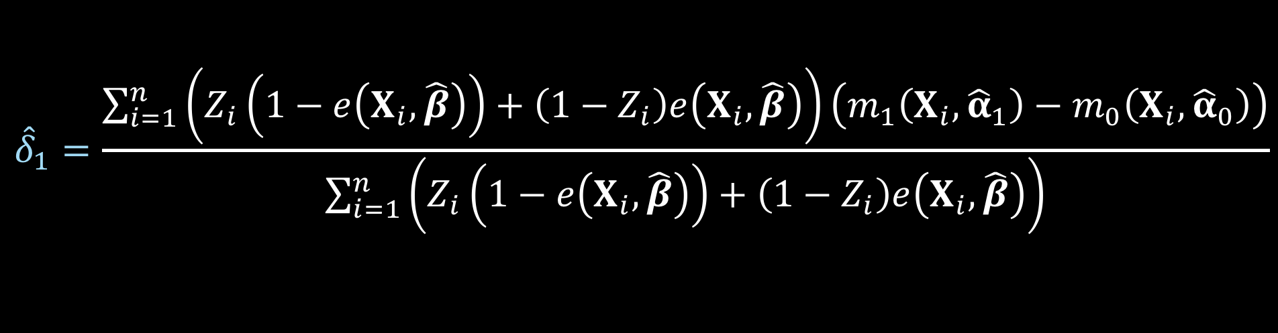
ATO DR estimator
Notes:
Here is delta 1

Slide 143
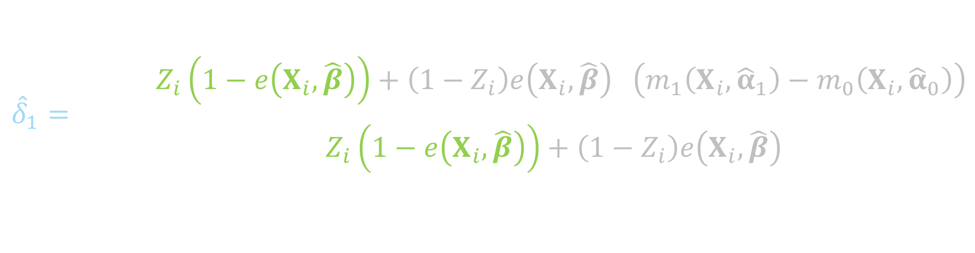
ATO DR estimator
Notes:
This will be weighted by 1 minus the propensity score for the treated

Slide 144
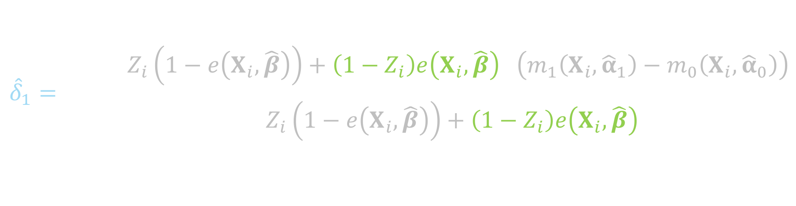
ATO DR estimator
Notes:
And the propensity score for the controls

Slide 145
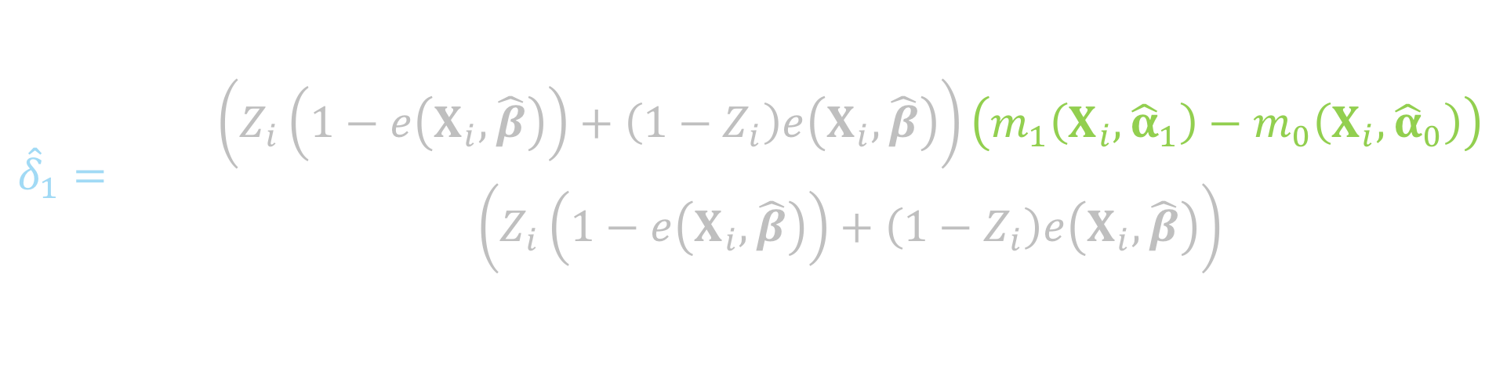
ATO DR estimator
Notes:
Here is the difference between the Y predicted among the treated and the Y predicted among the controls

Slide 146
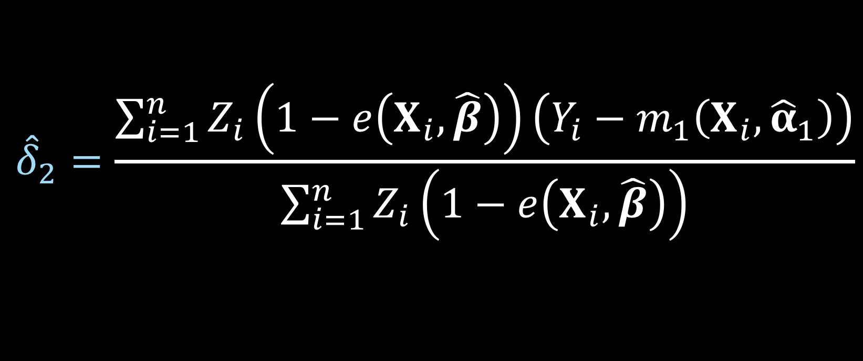
ATO DR estimator
Notes:
Here is delta 2

Slide 147
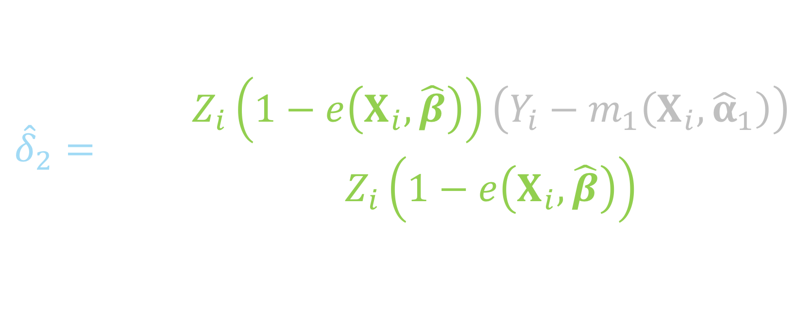
ATO DR estimator
Notes:
Notice this is just among the treated, so if the subject i is in the control group, this will be zero, since Zi will be 0

Slide 148
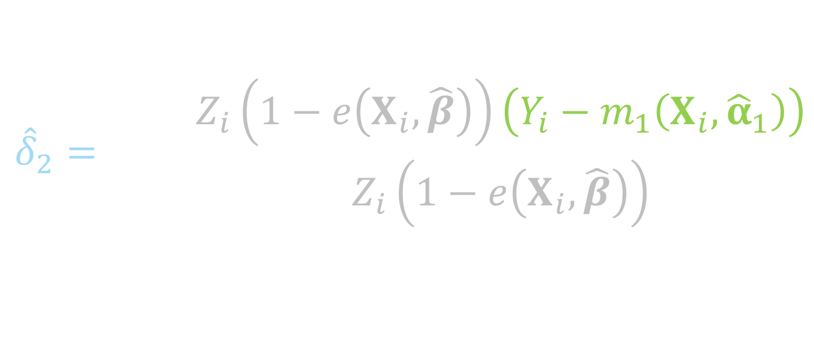
ATO DR estimator
Notes:
This piece is essentially the residual between the observed Y among the treated and the predicted Y among the treated

Slide 149
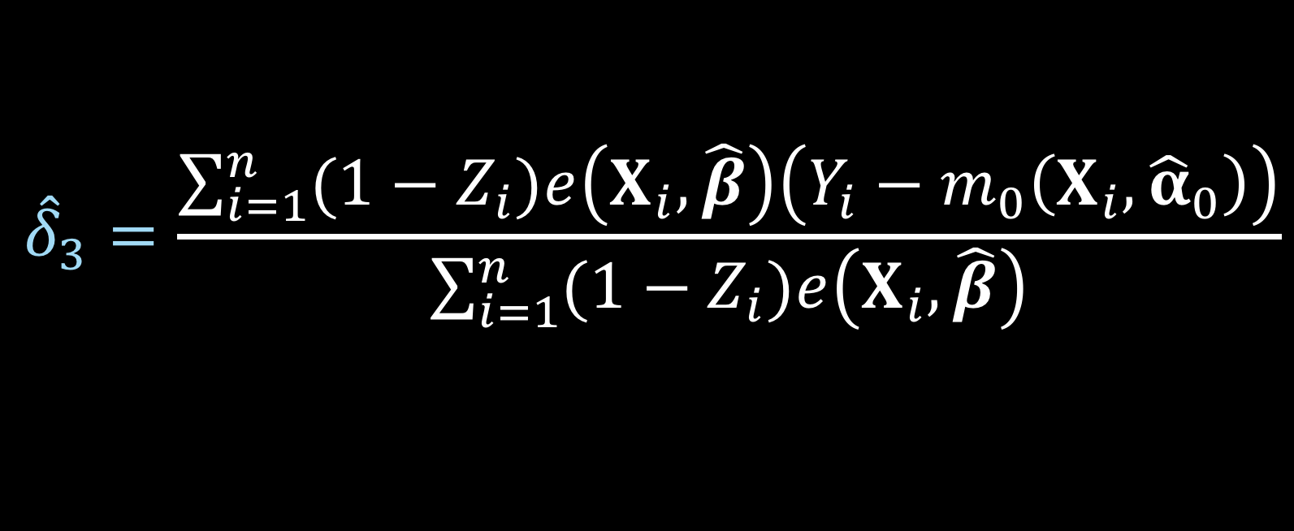
ATO DR estimator
Notes:
Here is delta 3

Slide 150
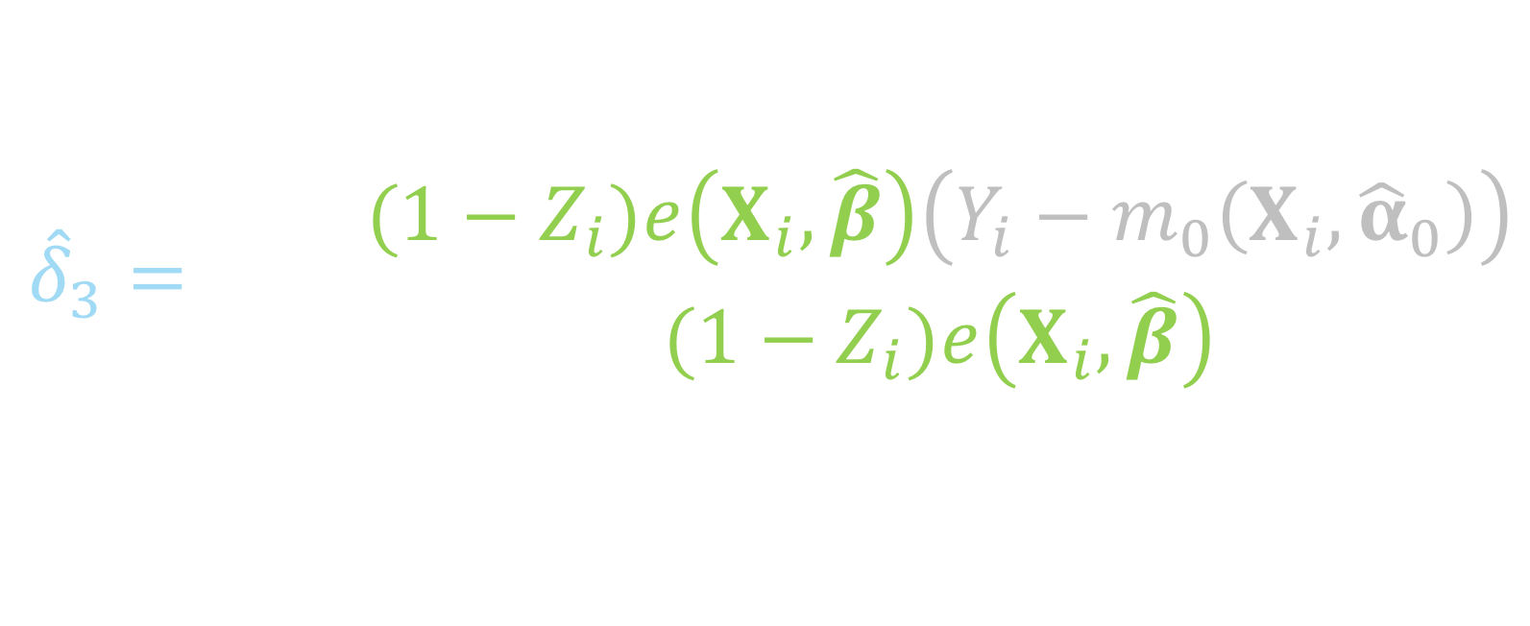
ATO DR estimator
Notes:
This summation is just among the controls, if the participant is in the treated group, 1 – Zi will be 0

Slide 151
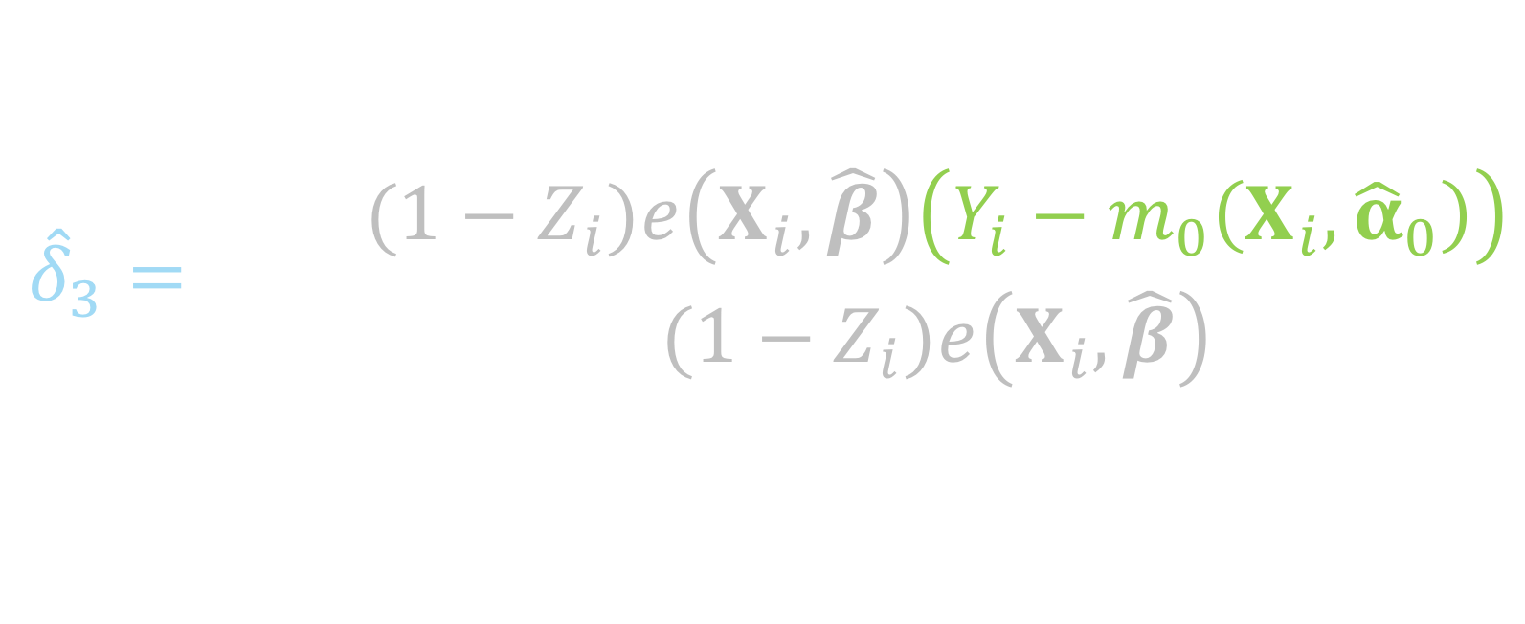
ATO DR estimator
Notes:
And this is the residual of the observed y among the controls and the predicted y, fit among the controls

Slide 152
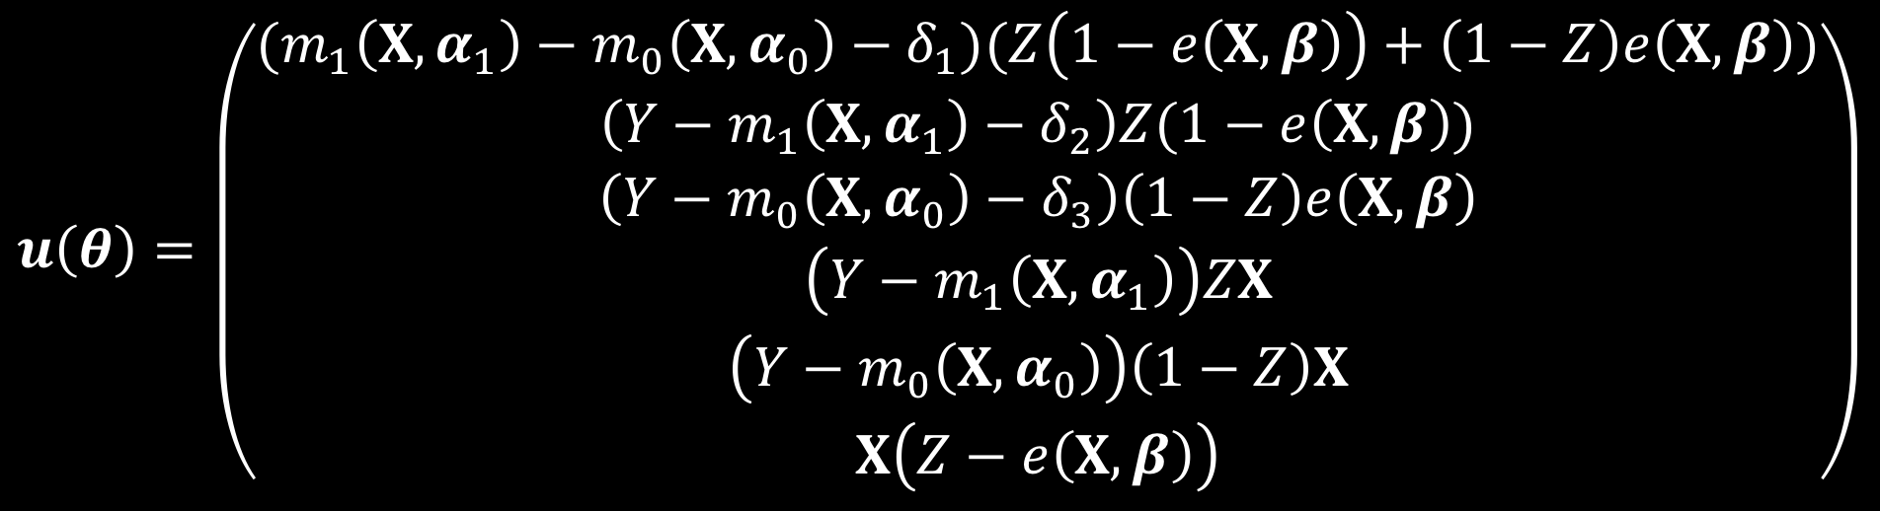
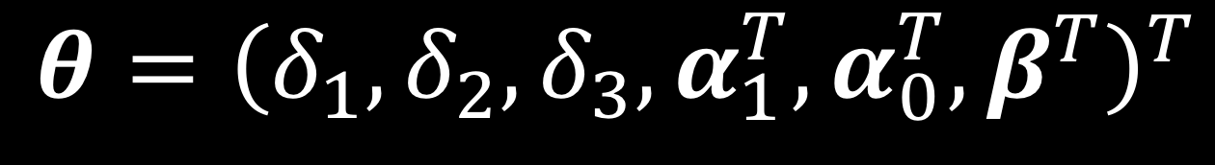
ATO DR estimator
Notes:
Again this can be solved by simultaneously solving these estimating equations. Note here that this technically will only be correct if both the outcome model AND the propensity score model are correctly specified.

Slide 153
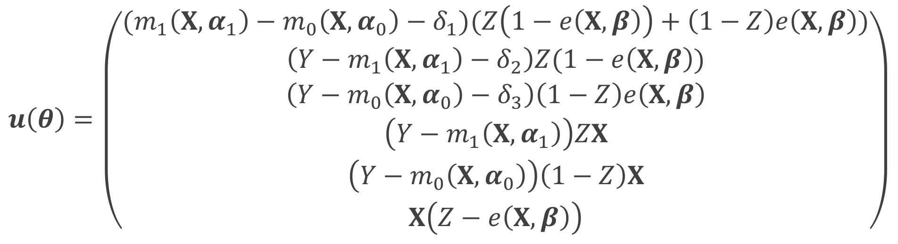
ATO DR estimator
Notes:
This is more complicated than the large-sample variance that we derived for the ATO IPW estimator because now we have more parameters to solve for, rather than just mu1, mu0 and beta, we now have delta 1 2 and 3, and alpha 1 and 0 from the outcome models

Slide 154
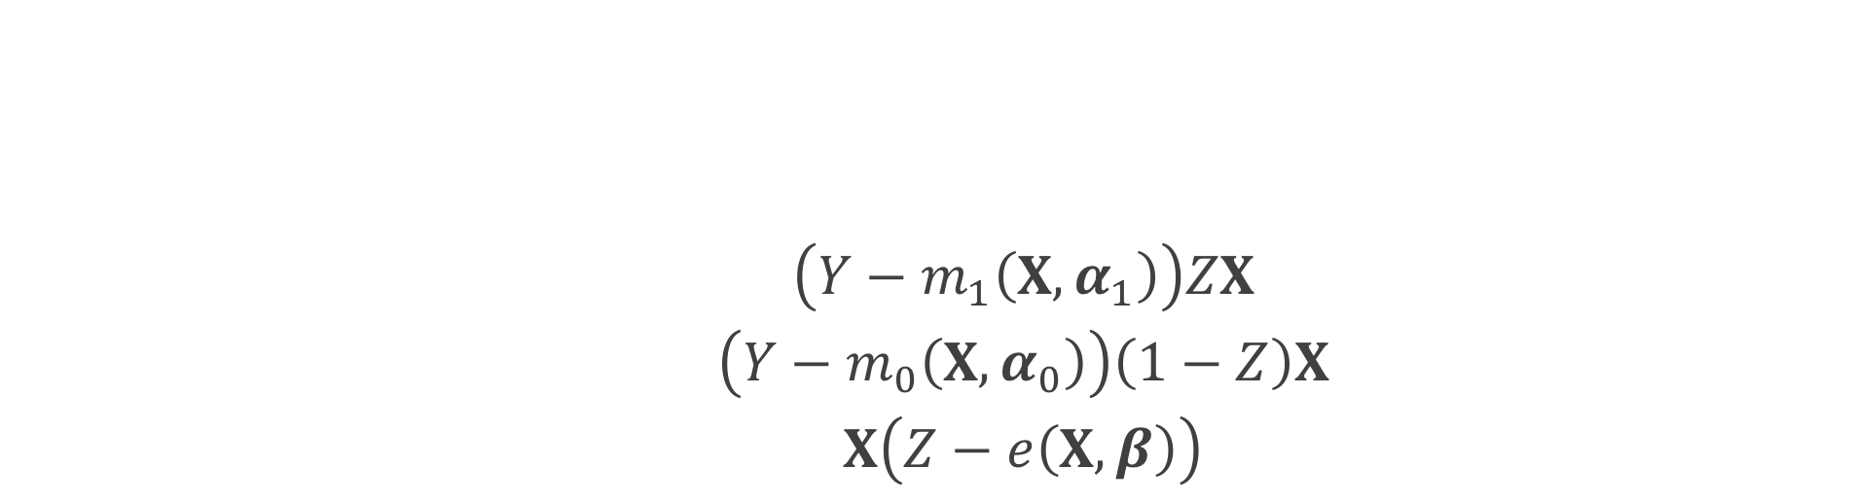

ATO DR estimator
Notes:
These first 3 lines are the estimating equations that make up the 3 parts of the doubly robust equation we just went through

Slide 155
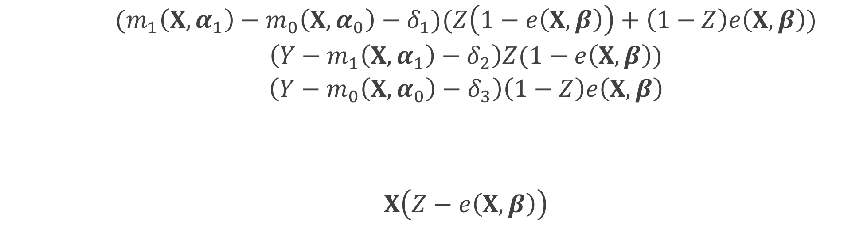
ATO DR estimator
Notes:
These two are the estimating equations for fitting the outcome models, the top is for the outcome model among the treated, the bottom is the outcome model among the controls

Slide 156
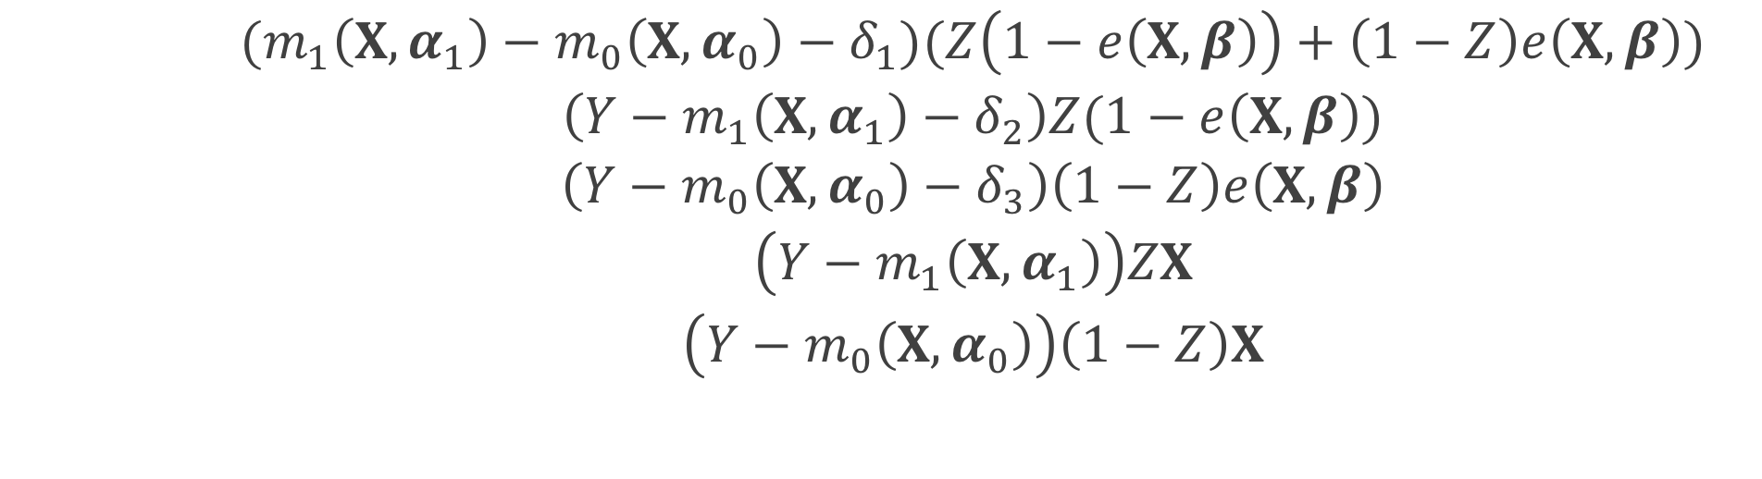
ATO DR estimator
Notes:
This final equation accounts for the propensity score model

Slide 157
ATO estimator
Notes:
we can estimate the propensity score and the treatment effect simultaneously in one step by solving the following estimating equations with respect to theta

Slide 158
M-Estimation
Notes:
Since these estimating equations are unbiased, U of theta is an example of an M-estimator. The asymptotic distribution of an M estimator is the following.
the negative T is just inverse transpose

Slide 159
Sandwich estimator

Slide 160

ATO DR estimator
Notes:
Because we are estimating delta 1 plus delta 2 minus delta 3, after we estimate our sandwich estimator

Slide 161

ATO DR estimator
Notes:
This will be our variance estimator where

Slide 162

ATO DR estimator
Notes:
We will multiply by the vector 1 1 -1 with the remaining entries 0 on both sides

Slide 163

ATO DR estimator
Notes:
We multiply by our estimated sandwich estimator where we've plugged in our sample averages for the expectations

